Slide 1
Training Notes
Rhea Mehta
Associate Data Engineer

Slide 2
Agenda
Safety briefing
Friday, 18th August, 2023
Monday, 21st August, 2023
Tuesday, 22nd August, 2023

Slide 3










Safety and Health On Site
On the Move
Ensure confidential discussions are not overheard
Have an emergency and evacuation plan in place
Do not take this call, or any other call, while driving – ever
Make sure your workspace is ergonomically sound
Ensure understanding of fire safety
Do not use any hands-free device – Bluetooth, built-in, etc. – whilst driving
Know what the fire alarm sounds like
Make sure that you can hear the fire alarm
Make sure your smoke alarms work
Maintain clear walkways and fire exits
Ensure adequate lighting in the room when you work
Continue to follow COVID guidelines
In the event of any kind of emergency, please leave the call – promptly and safely
Clean surfaces frequently

Slide 4
Introduction to Business Analysis
Friday, 18th August, 2023

Slide 5
Introduction to Business Analysis
Business Analyst – Identifies business needs, gathers and analyses requirements, fills gap between customer and team.
Requirement Analysis
– Process of defining user needs,
-- Identify, analyse, and model functionality
Functional: Mandatory, helps verify functionality, user requirement, What product does
Non-Functional: Not Mandatory but good to have, helps verify performance, user experience, How product works.
Requirement Elicitation (research and discover requirement, e.g. brainstorm, focus groups)
Requirement Modelling (the application or system needs to meet certain requirement for a project)
Requirement Management (To reduce cost, improve quality, decrease time taken and decrease risk)

Slide 6
Requirement Management Techniques are:
-- Work Breakdown Structure
-- Gantt Chart
-- Critical Path Method
-- Waterfall Method:
Advantage: If requirement is well known and time isn’t an issue, can use
Disadvantage: client can’t see the project until the end, takes a lot of time
-- Agile Method: Introduction
Assignment on Requirement Traceability given: Create a requirement traceability log on Excel for a log in page.

Slide 7
Agile and DevOps
0.2
Monday, 21st August, 2023

Slide 8
Introduction to Agile
What is Scrum? 2-4 weeks sprint, specific project completion, cross functional teams, board reset between each sprint, scrum master oversees everything, daily scrum meetings (stand up session)
Scrum Events
-- Sprint: time period when the work gets complete
-- Sprint Planning: what can be delivered and what work is needed to deliver it
-- Daily Scrum: meeting to discuss yesterday work, current work, & impediments
-- Sprint Review: held at end of each sprint to review accomplishments and review product backlog
-- Sprint Retrospective: team introspects itself
Epic: broad overview of the user stories
User Story: a requirement in low detail that can be estimated
Story Pointing: unit of measurement to determine effort needed for a task, e.g. Fibonacci series, T-shirt sizes

Slide 9
DoR: Definition of Ready, user story needs to meet certain criteria before being ready
DoD: Definition of Done, user story is complete and can go for testing.
Kanban: optional 2-4 weeks or more, commitment optional, specific teams allowed, persistent board (doesn’t need to be updated every sprint).
Burndown charts vs Burnup charts: Burndown is daily and Burnup is according to iteration.
Velocity Chart: Overview of how much work is completed in each sprint. (Average of total story points over last 5 sprints.

Slide 10
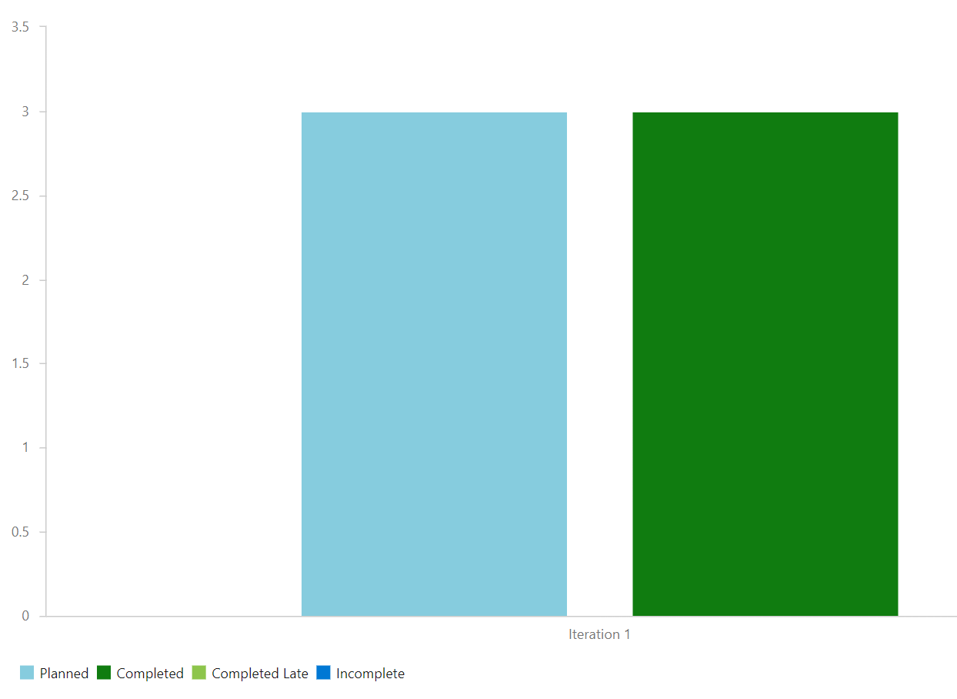
DevOps Activity
Make account on Azure DevOps, create new project, title project, write epic, add user stories, link user story to epic, add subtasks to user stories such as Requirement Analysis, System Development, Review, System Testing, etc.
Then, add amount of estimated time to complete each task, and story points of each user story according to importance. After marking tasks as complete, view the velocity table.
Fig. 1: Velocity chart of the sprint

Slide 11
DBMS
0.3
Tuesday, 22nd August, 2023

Slide 12
DBMS
What is DBMS?
Types of Databases
SQL Normalization Forms: 1NF, 2NF, 3NF, BCNF, 4NF
PostgreSQL
SQL Commands: Create, Drop, Select, etc.
Types of Joins: Outer, Inner, Cross.

Slide 13
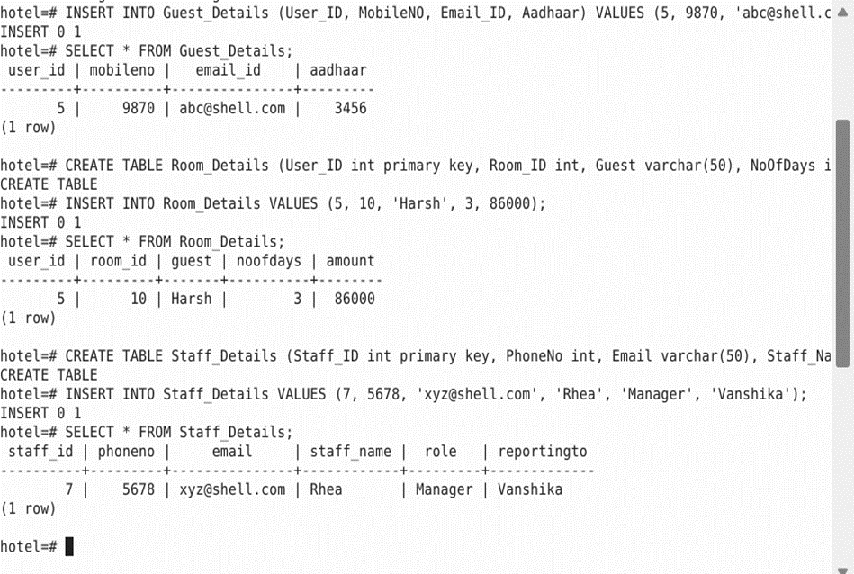
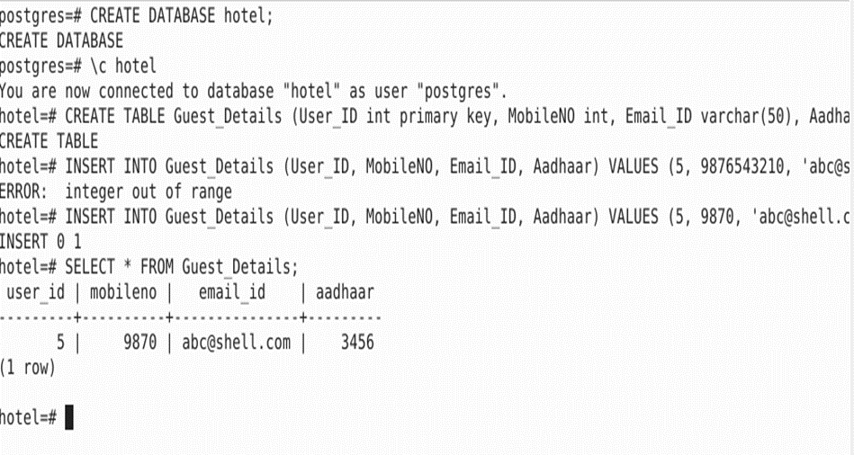
SQL Screenshots

Slide 14
Software Testing
0.4
Wednesday, 23rd August, 2023

Slide 15
Intro to Software Testing
Requirement Analysis -> low level design -> high level design -> coding -> Integration testing -> System testing -> production.
3 Types of Testing: Black box, white box, grey box.
STLC: Test Strategy -> Test Plan -> Test Design -> Test Environment -> Test Execution -> Defect Reporting -> Test Closure.
Functional vs Non-Functional testing
Unit testing Load Testing
Integration testing Stress Testing
System testing
Regression testing
Smoke testing
Sanity testing
Adhoc Testing

Slide 16
Severity – low, medium, high, critical, priority
Software testing: static, dynamic
TDD: Test Driven
BDD: Behavior Driven
DDD: Domain Driven
ATDD: Automated Test Driven.

Slide 17
DevOps
0.5
Thursday, 24st August, 2023

Slide 18
Day 5: DevOps
Combination of Development and Operations, is neither app nor a tool, it is a culture to promote development and operations.
Types of Environment: Local -> Central dev environment -> Test -> Pre-production -> Staging -> Production.
Why DevOps? Everything in one place (testing, requirements, operations), earlier no automated environment for deployment or testing.
DevOps Lifecycle: 1. Cont. Development 2. Cont. Integration 3. Cont. Testing 4. Cont. Deployment 5. Cont. Monitoring 6. Continuous Feedback 7. Cont. Operations.
DevOps Principles: Automation (everything), Iteration (done in small chunks), Continuous Improvement (cont. testing & learning from failures) and Collaboration (unites teams).

Slide 19
Benefits: Faster, higher ROI, greater customer satisfaction, higher efficiency and collaboration, early detection correction of issues.
CI - Continuous Integration, changes merged into central repo, known for revision control, automated testing and build automation.
Importance: reduces risk, better communication, high product quality, low waiting time.
CD: Continuous Deployment, or delivery, automated release process, and continuous feedback from customers as they can view every change.
CI/CD Platform: GitHub.
GitHub actions: workflows -- event – jobs -- actions -- runners.

Slide 20
Cloud Computing
0.6
Friday, 25th August,
2023

Slide 21
Cloud Computing, GitHub Actions, VM
What is Cloud Computing?
Cloud Service models: SaaS, PaaS, IaaS
Cloud Computing Service Layers
Virtualization – VM on Azure
Advantages and Disadvantages of Cloud Computing
Popular Cloud Computing platforms
GitHub Actions: YML file

Slide 22
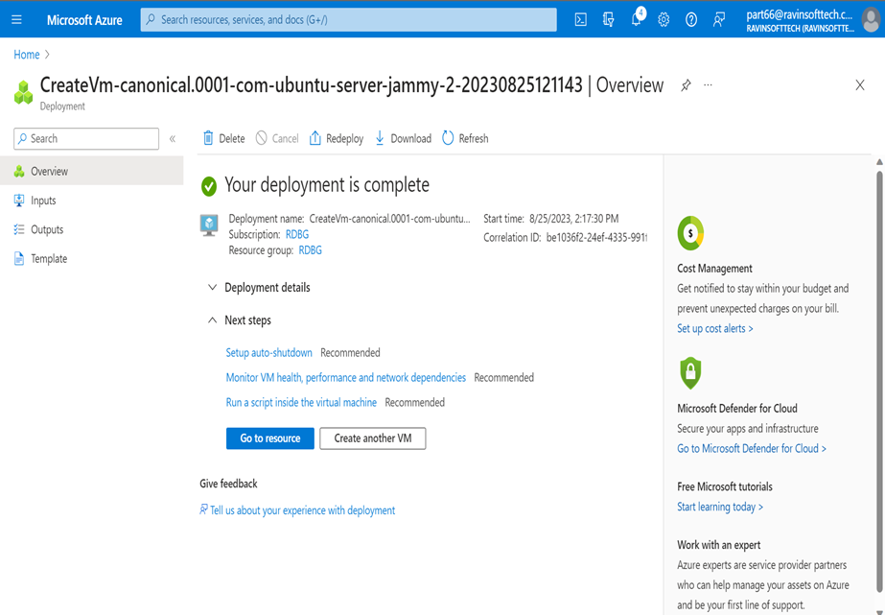
VM Screenshot

Slide 23
Case Study
0.7
Monday, 28th August, 2023

Slide 24
Case Study
Case Study – Deployment of Java Spring Boot App
Azure DevOps
Azure VM
Azure Web App services
GitHub – fork, feature branch, pull request, merge
GitHub Actions – Automate Workflow
Docker – make docker image and dockerfile
Maven – run maven package
Prometheus – to monitor local environment

Slide 25
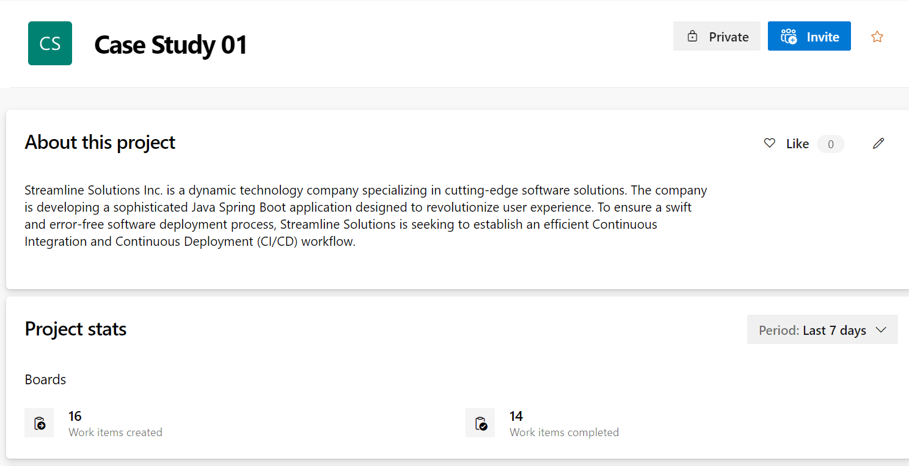
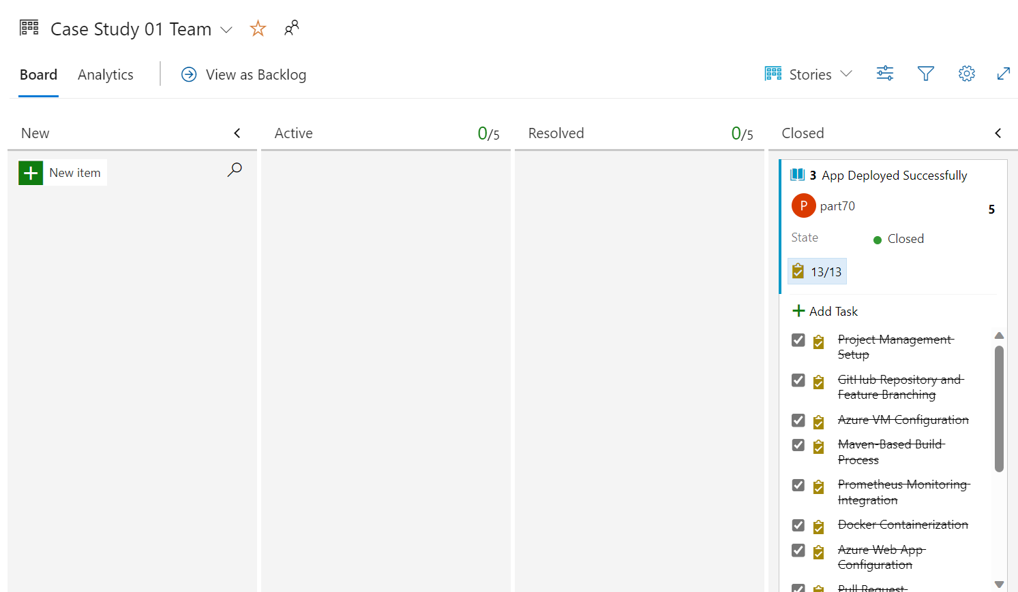
Project Management Setup

Slide 26
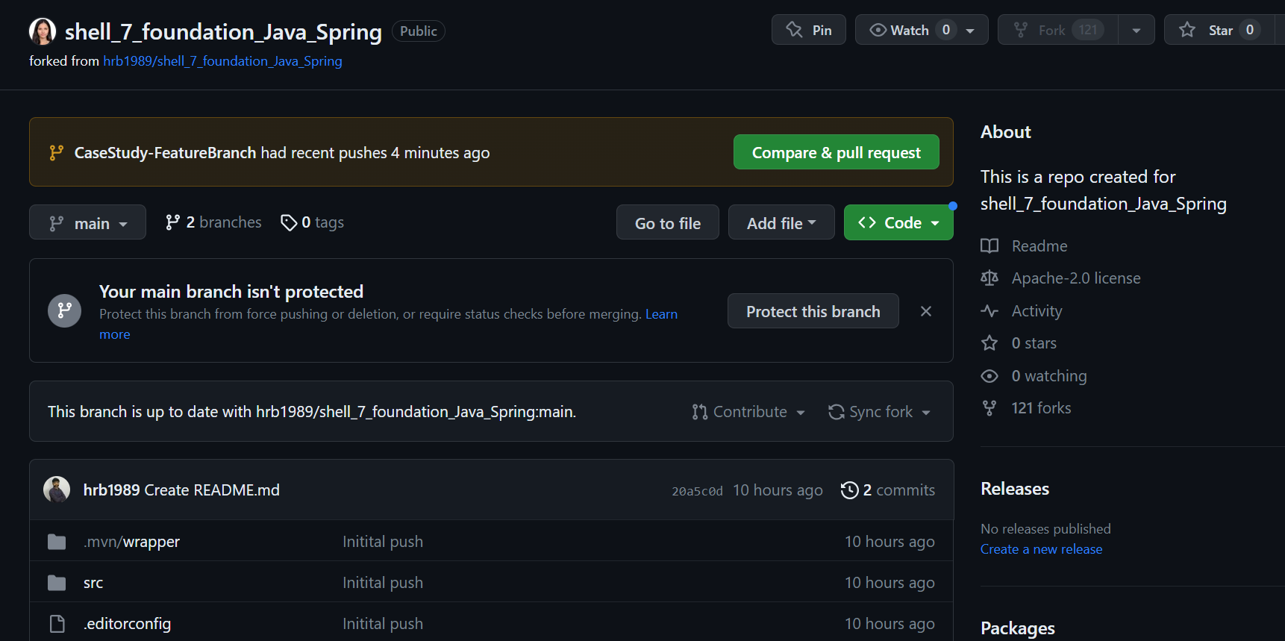
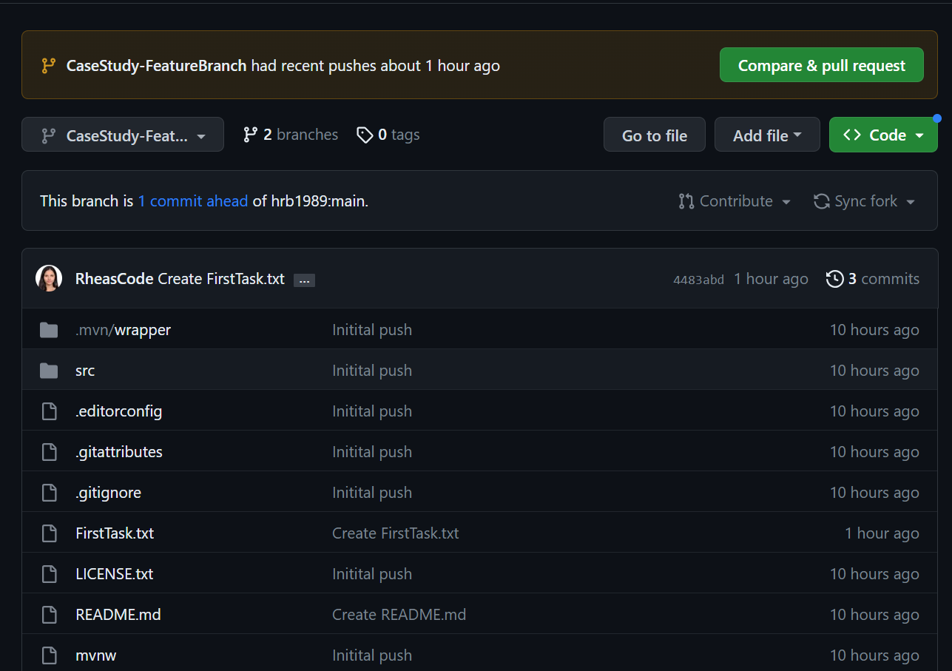
GitHub Repository and Feature Branching:

Slide 27
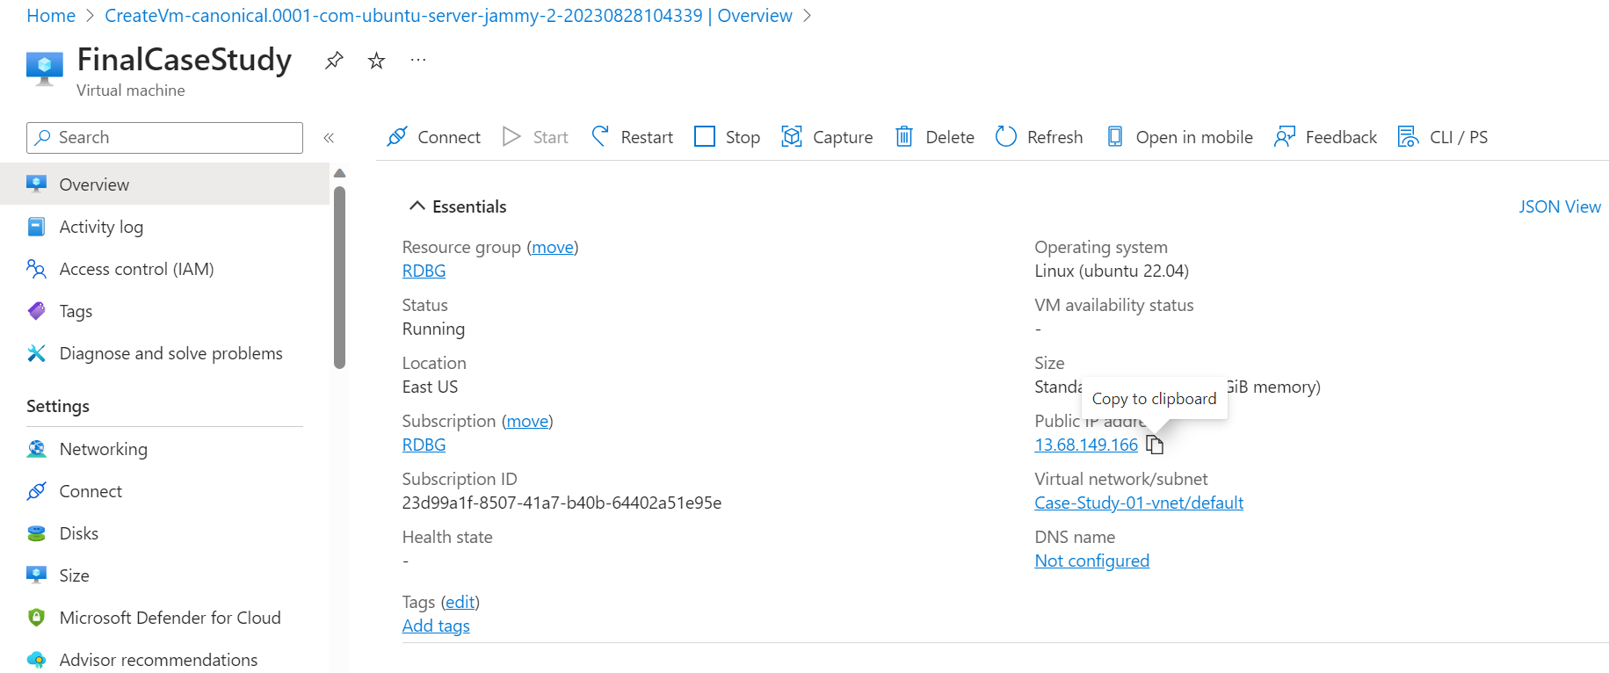
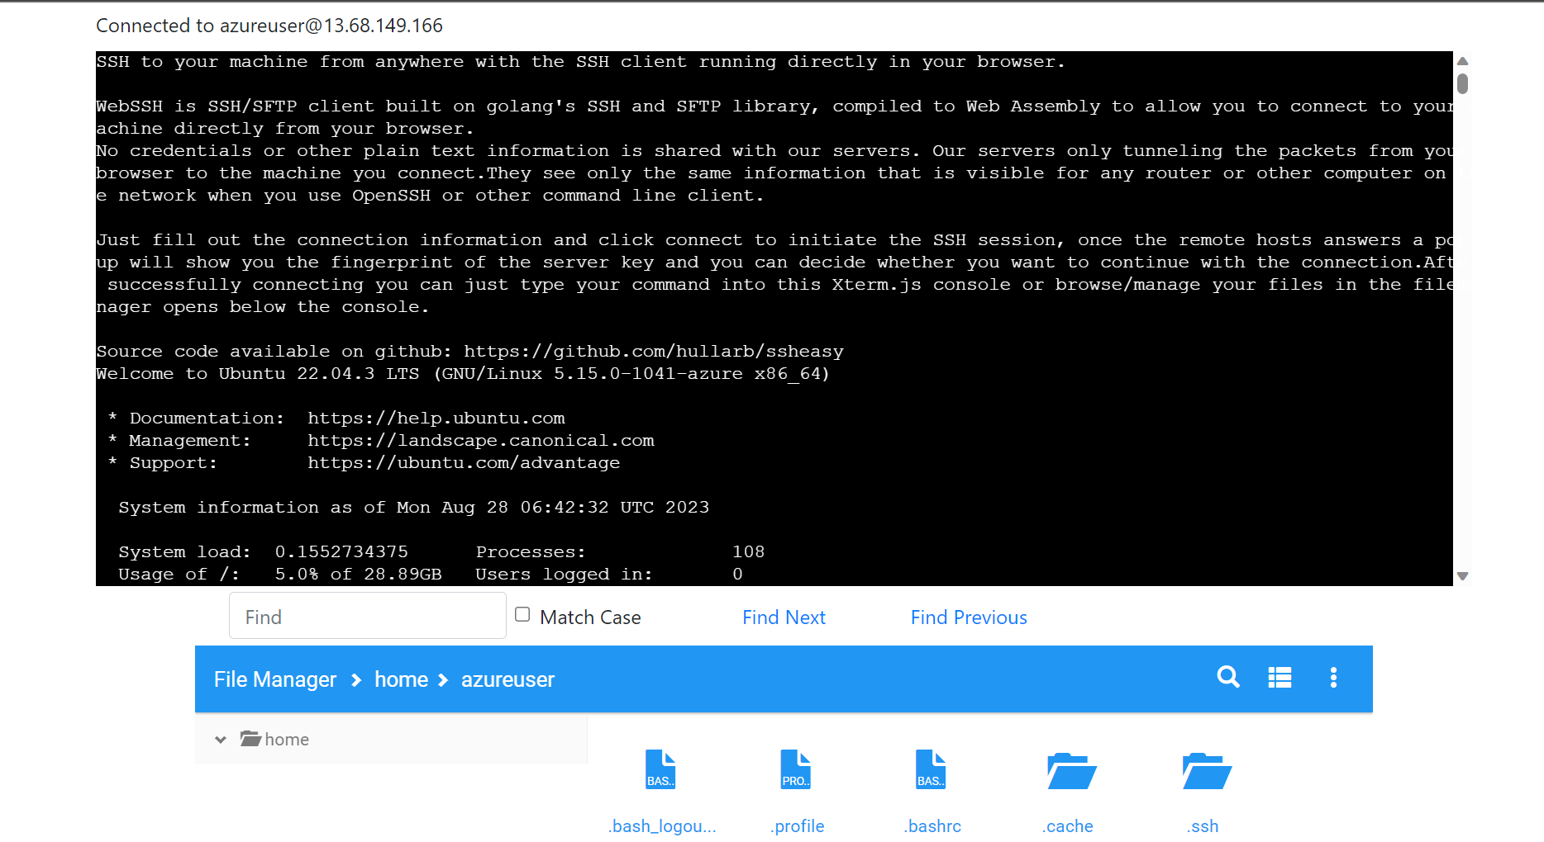
Connect To VM and ssheasy.com

Slide 28
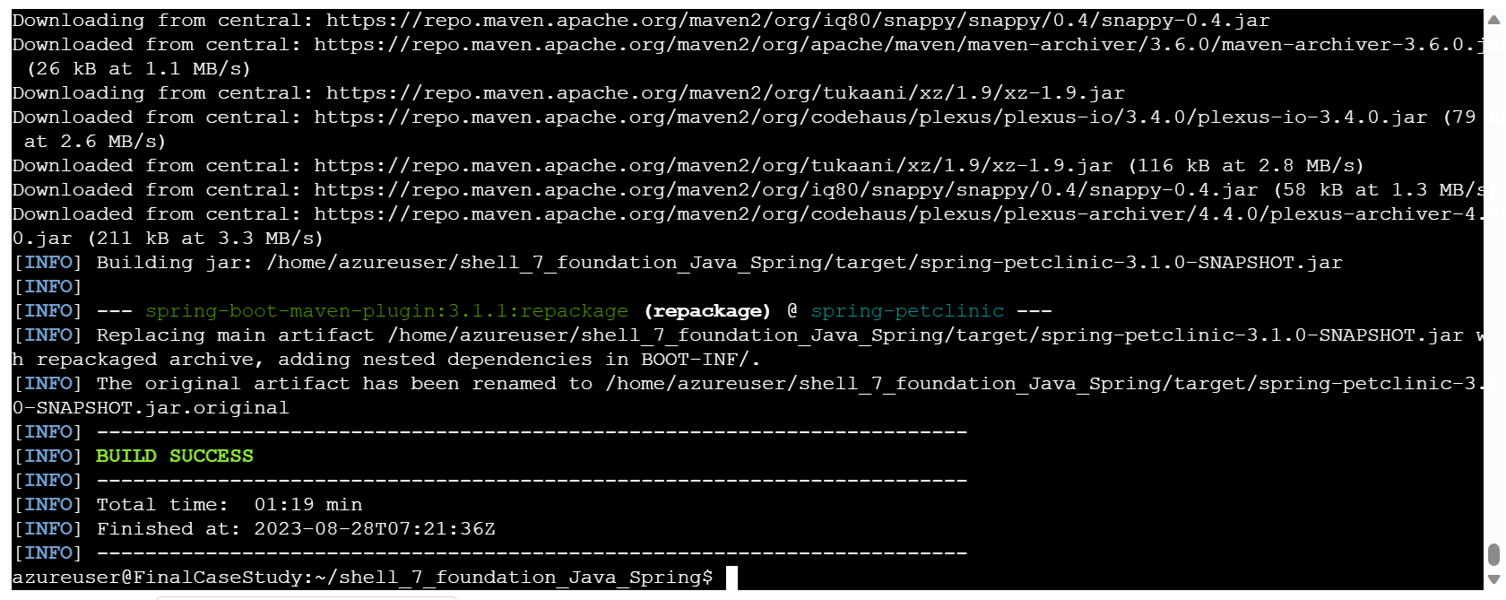
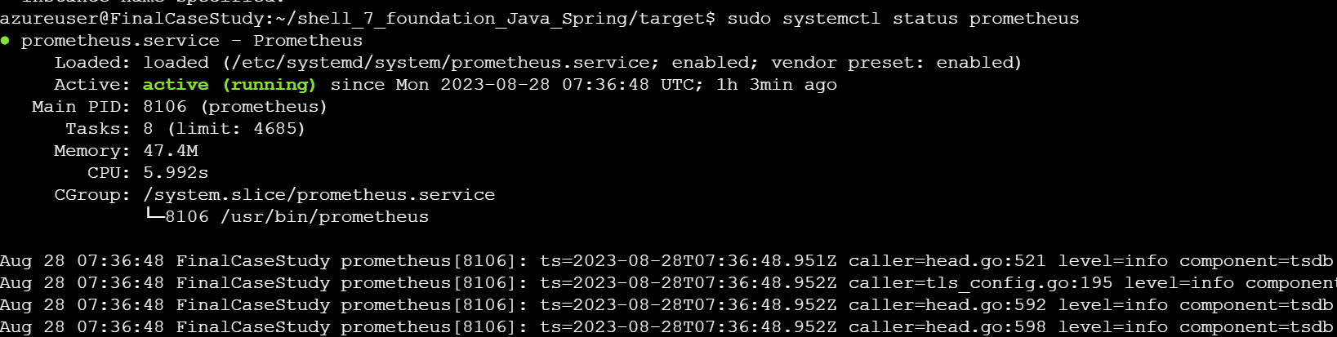
Maven and Prometheus

Slide 29
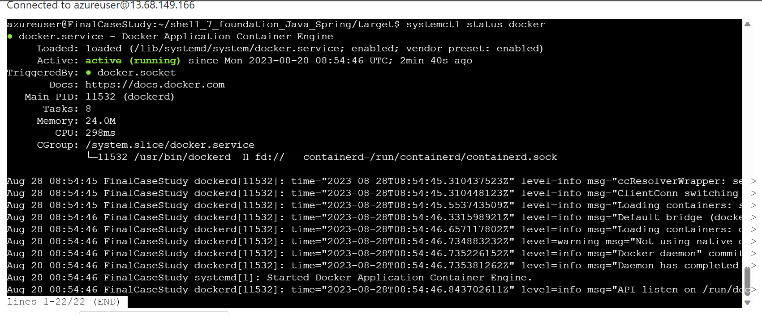
Docking

Slide 30
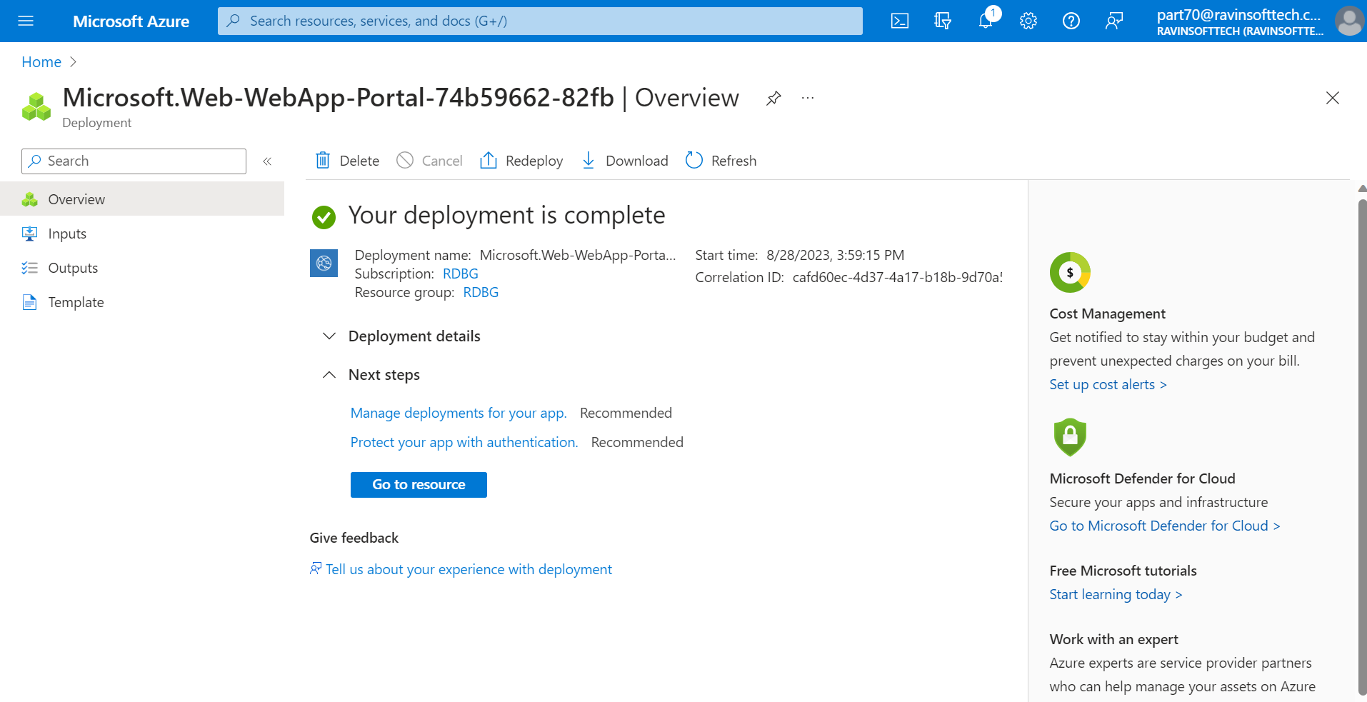
Web App Creation

Slide 31
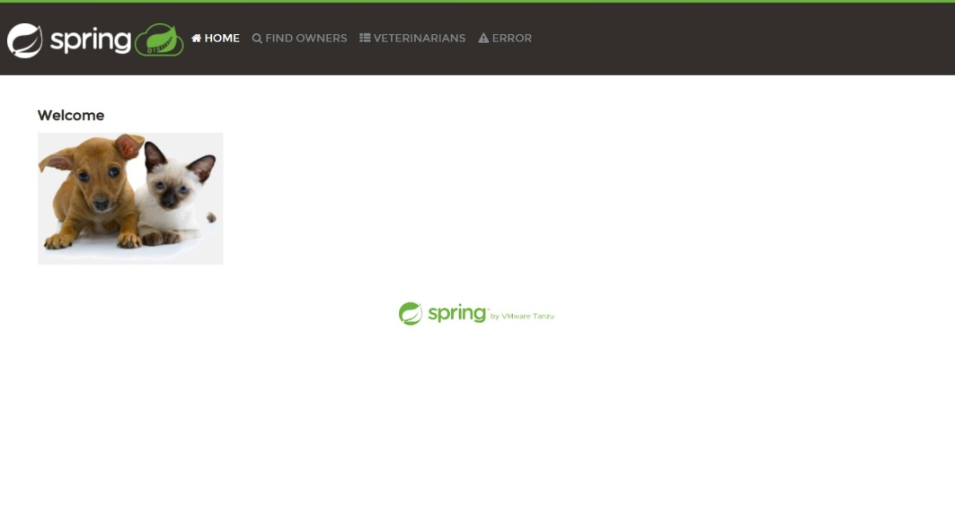
Website

Slide 32
DBMS, Data Fundamentals
0.8
Tuesday, August 29th, 2023

Slide 33
DBMS, Data Fundamentals
What is Data?
Piece of Info
Data needed to retain customers, to know capacity, targeted ads
Types: Structured (excel, schema), Semi-structured (json, no schema), Unstructured (media)
What is Database?
Tables, Views, etc.
Primary Key: Unique and Not Null, need it to identify which id is being referred to
Unique Key: Unique values, not repeated, can be null
Foreign Key: Should be primary key in another table
Candidate Key: Combination of two keys
Super key: superset of all keys

Slide 34
ER Diagram
1NF -> Each table has only 1 value, and column names are unique.
2NF -> 1NF and no partial dependency (partially dependent on a primary key), each non key is directly dependent on primary.
3NF -> all non-key attributes are independent to each other
BCNF -> all non-key attributes dependent on candidate keys
Dimensional Modeling
Star vs Snowflake Schema: In snowflake there will be multiple links, whereas in star there is one central table connecting all.
SCD: Slowly Changing Dimension: SCD1, SCD2, SCD3

Slide 35
Big Data
0.9
Wednesday, August 30th 2023

Slide 36
Big Data
What is Big Data?
Data that is huge in volume, variety, velocity, veracity (Uncertainty of data, data in motion, or at rest)
Batch vs Stream Processing: streaming data is immediate, constant sending of data, real time events
Batch takes time, recorded events
Stream Analytics:
get 360 degree view of customer, what they require and need from the company
Recommender Systems: if pant is bought, t-shirt recommended
Sentiment Analysis: collect feedback from customer, if positive negative neutral
Hadoop: framework for batch processing, distributed processing
Spark: for stream processing, supports multiple languages, we will learn pyspark
Data Warehousing vs Data Lake vs Lakehouse: Data warehouse has structured data with fixed schema with ACID properties whereas data lake has all types of data but no ACID. Lakehouse is combination of both.

Slide 37
Serverless Computing: cloud provider automatically provisions scales and manages infra required to run the code. E.g. Azure functions and Azure Apps.
Cloud Benefits: High availability, scalability, fault tolerance, elasticity (can expand), global reach, agility (responding to market change, new trends there in public cloud), predictive cost consideration, disaster recovery, security.
Capex: Expenditure of everything, infra network engineer salary, maintenance, etc.
Opex: pay as you go, get billed immediately, spend on products and services as needed. [consumption based model]
IaaS: only skeleton needed, eg. Server, machines etc. so only infrastructure needed.
PaaS: till runtime env, everything given but application and data and access is your own.
SaaS: Only data and access is your own, rest provided.
Resource group: container that holds all your resources in one place, for example, Storage, VM, web and db.

Slide 38
Azure SQL Day 1
10
Thursday, 31st August, 2023

Slide 39
Azure SQL Day 1
How to create and configure an SQL database on Azure
What is View? Use create view when you want to keep data confidential and not give the whole db access, so you'd join tables in the view and give that view to the dev
DDL; Data Definition, create table etc
DML: Data Manipulation, insert into table etc
DCL: Data Control, grant access
Implemented today: Schemas, DDL statements: create, truncate, drop, Constraints: Update, delete, grouping, having clause.

Slide 40
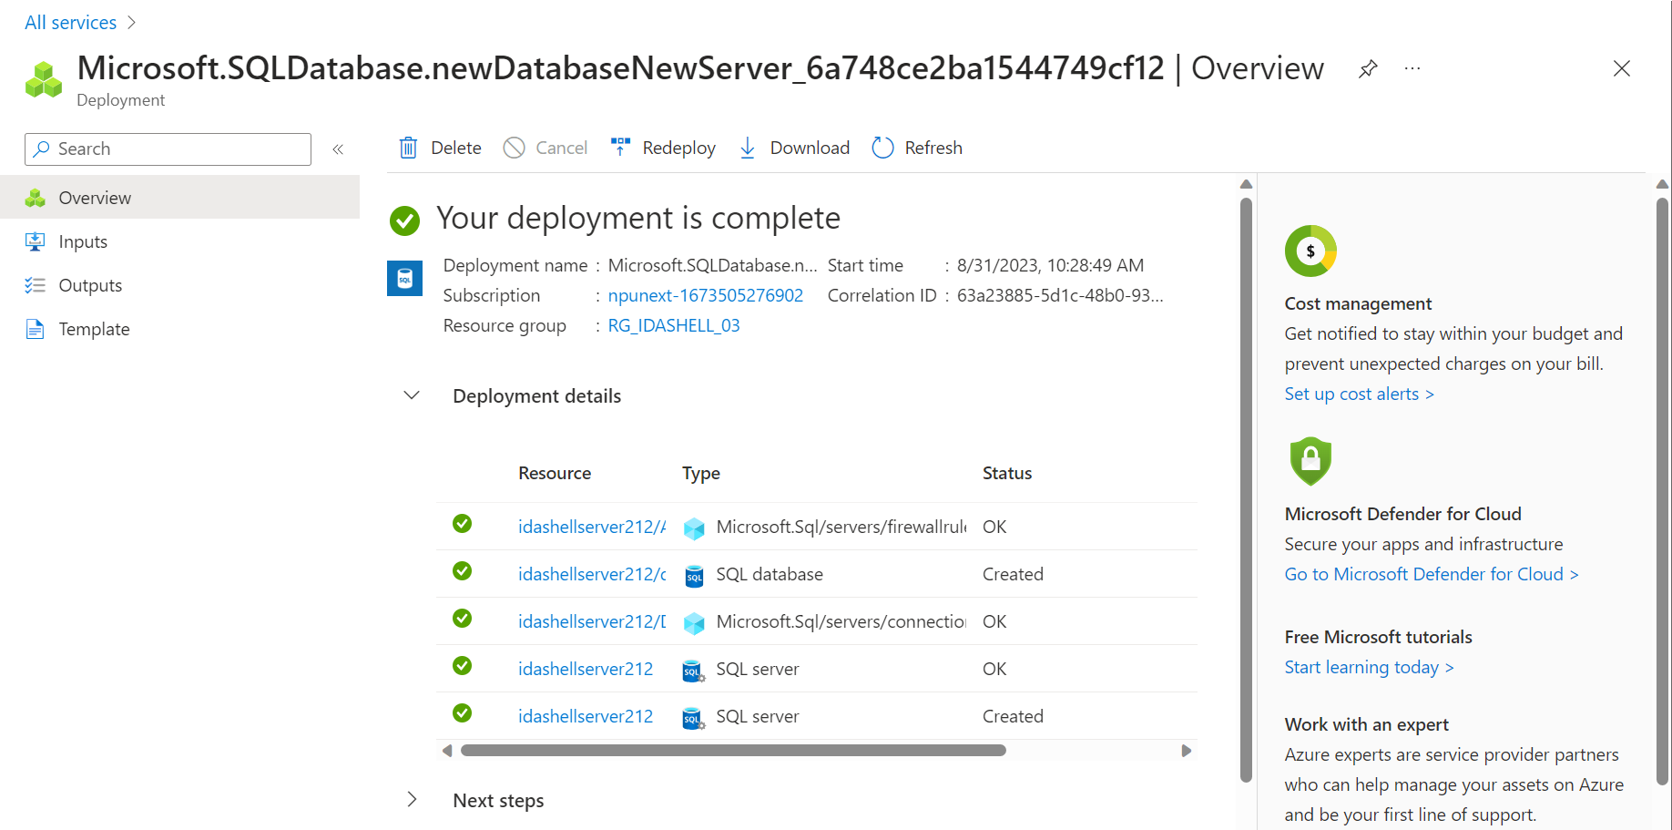
SQL Database successfully deployed

Slide 41
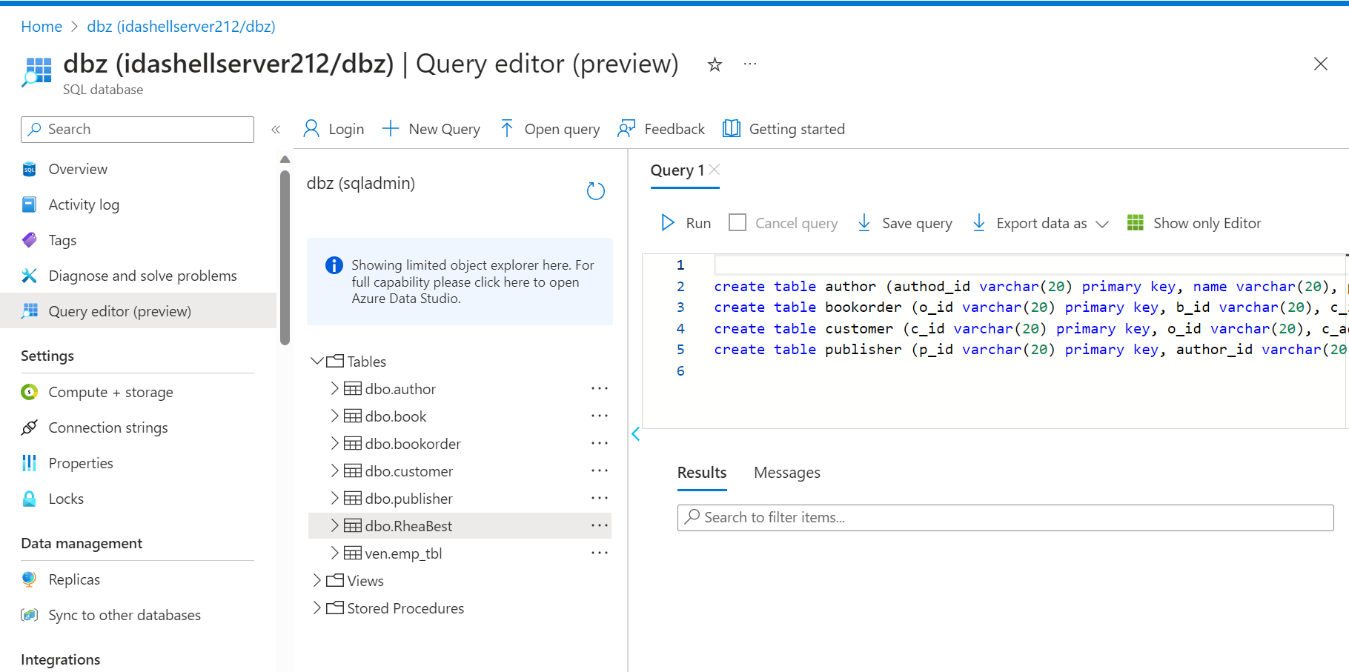
Query editor

Slide 42
Azure SQL Day 2
11
Friday, 1st September, 2023

Slide 43
Azure SQL Day 2
Alter table query:
alter table bookorder add doi date not null default (getdate())
Joins:
Inner: brings only the matching records from both tables
Left: returns all rows from left table and matching values from right table
Right: returns all rows from right table and matching values from left table
Self: each row is joined to itself and all other rows
Outer: all rows from both tables
Cross: returns the cartesian product of both tables.

Slide 44
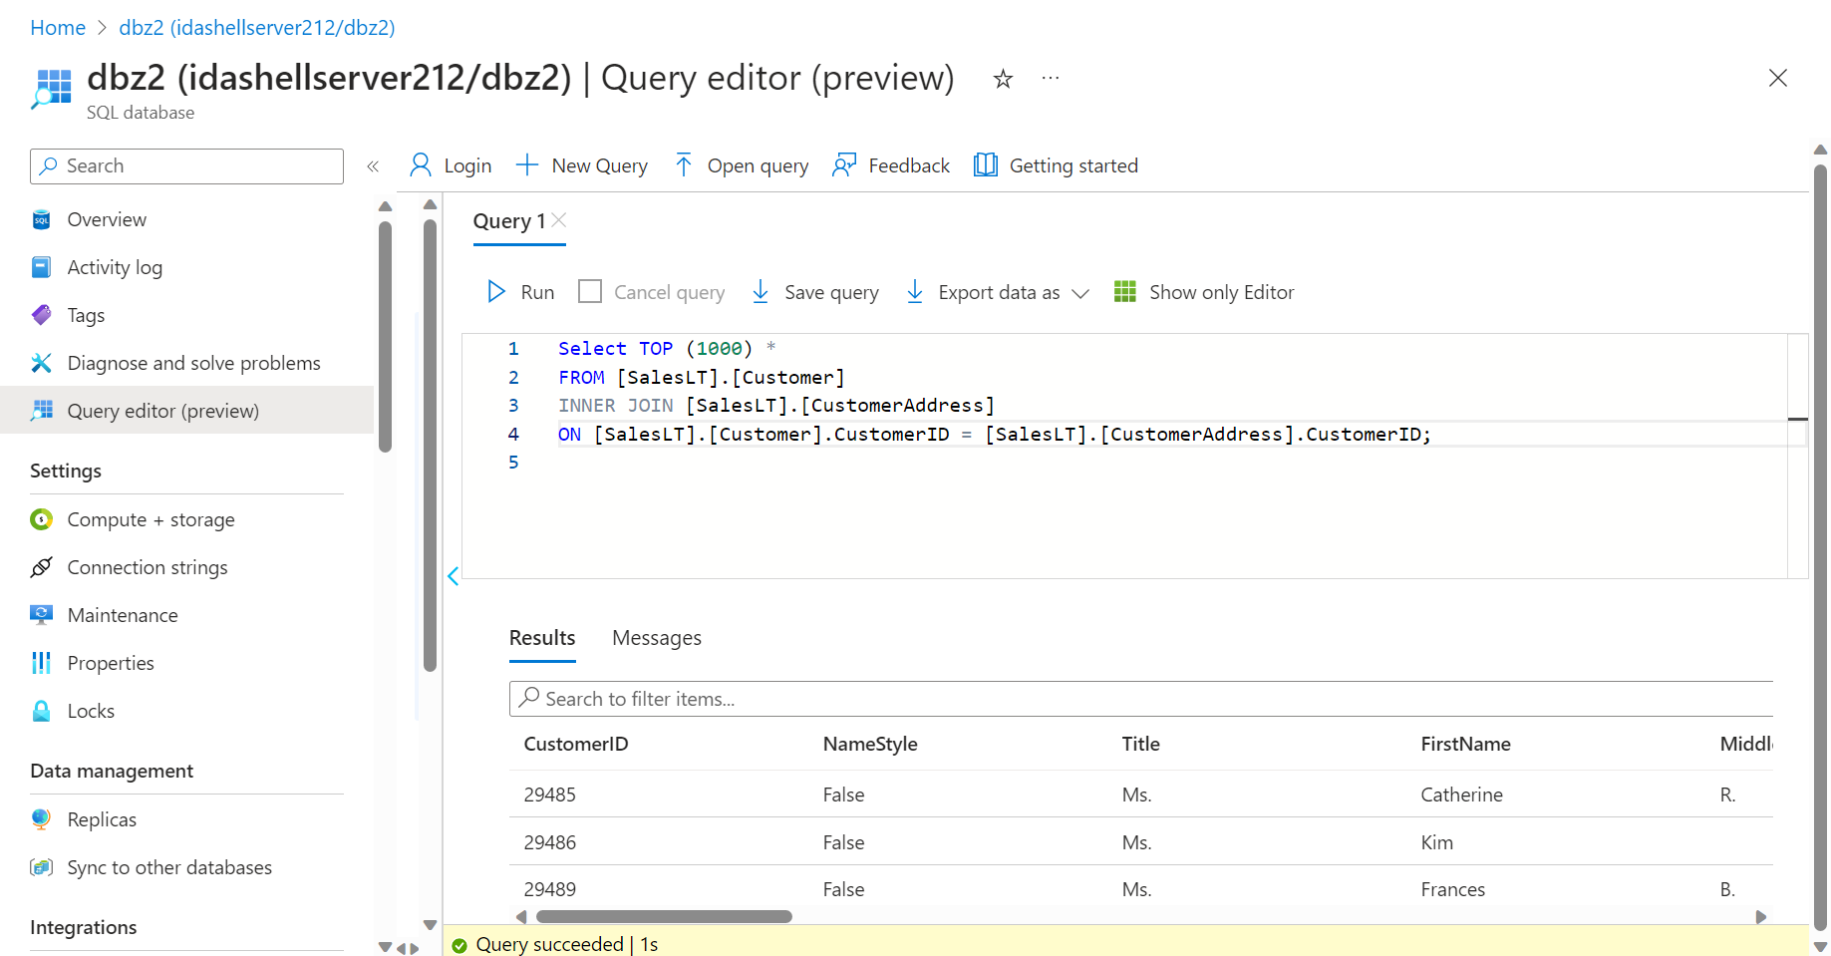
When to use Views vs Functions vs Stored Procedure:
When same procedure needs to be repeated: then use Function, it is piece of code that helps reduce code overwrite and helps in reusability
Complex code that needs automation: then use Store Procedure
Hundreds of tables but only want to give some part to someone: Views

Slide 45
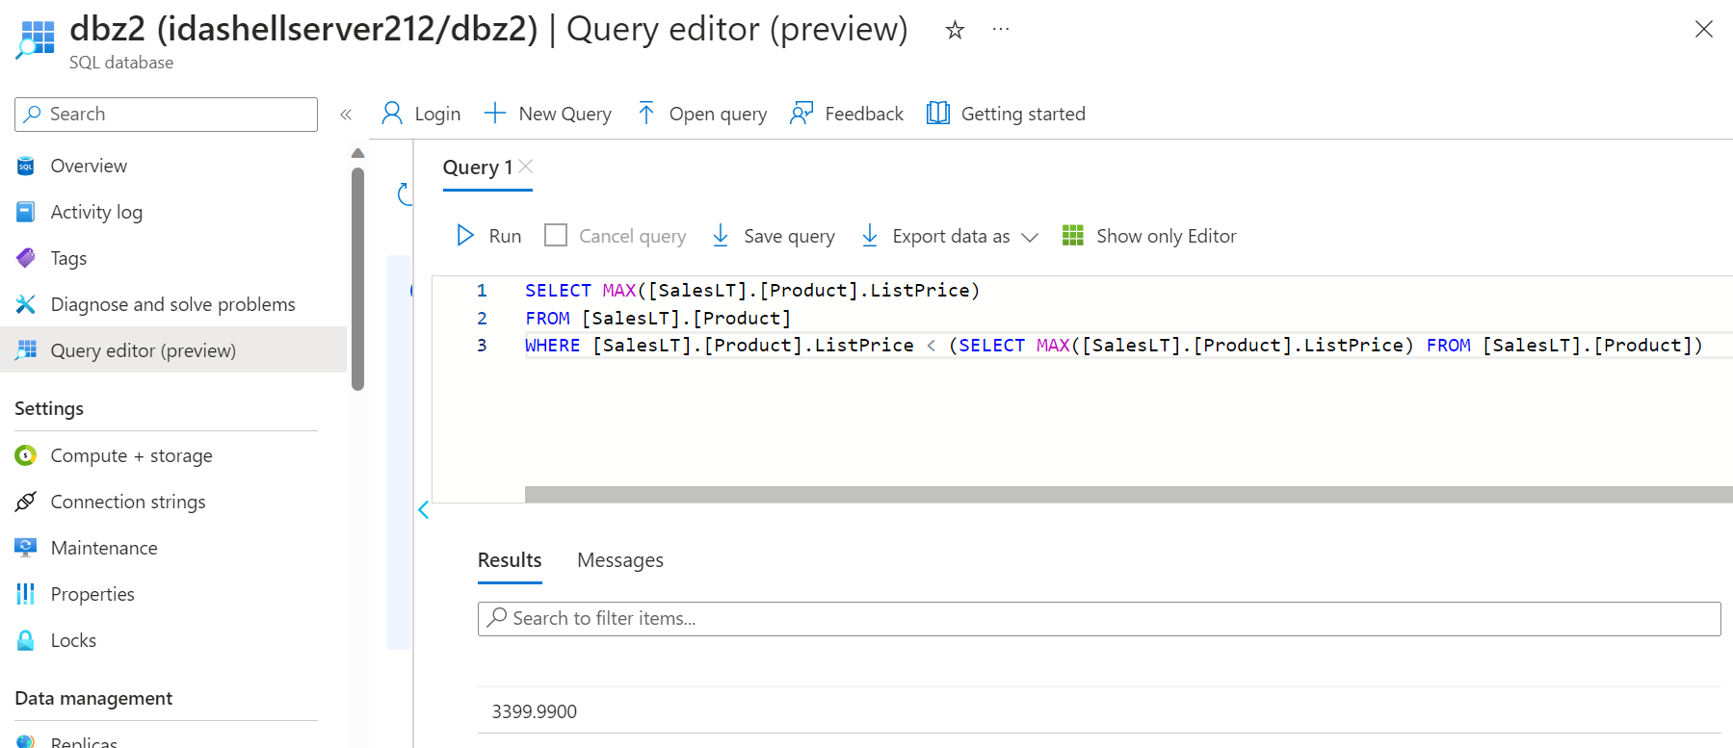
Subquery for second highest product price

Slide 46
Azure Storage Account and File Share
12
Monday, 4th September, 2023

Slide 47
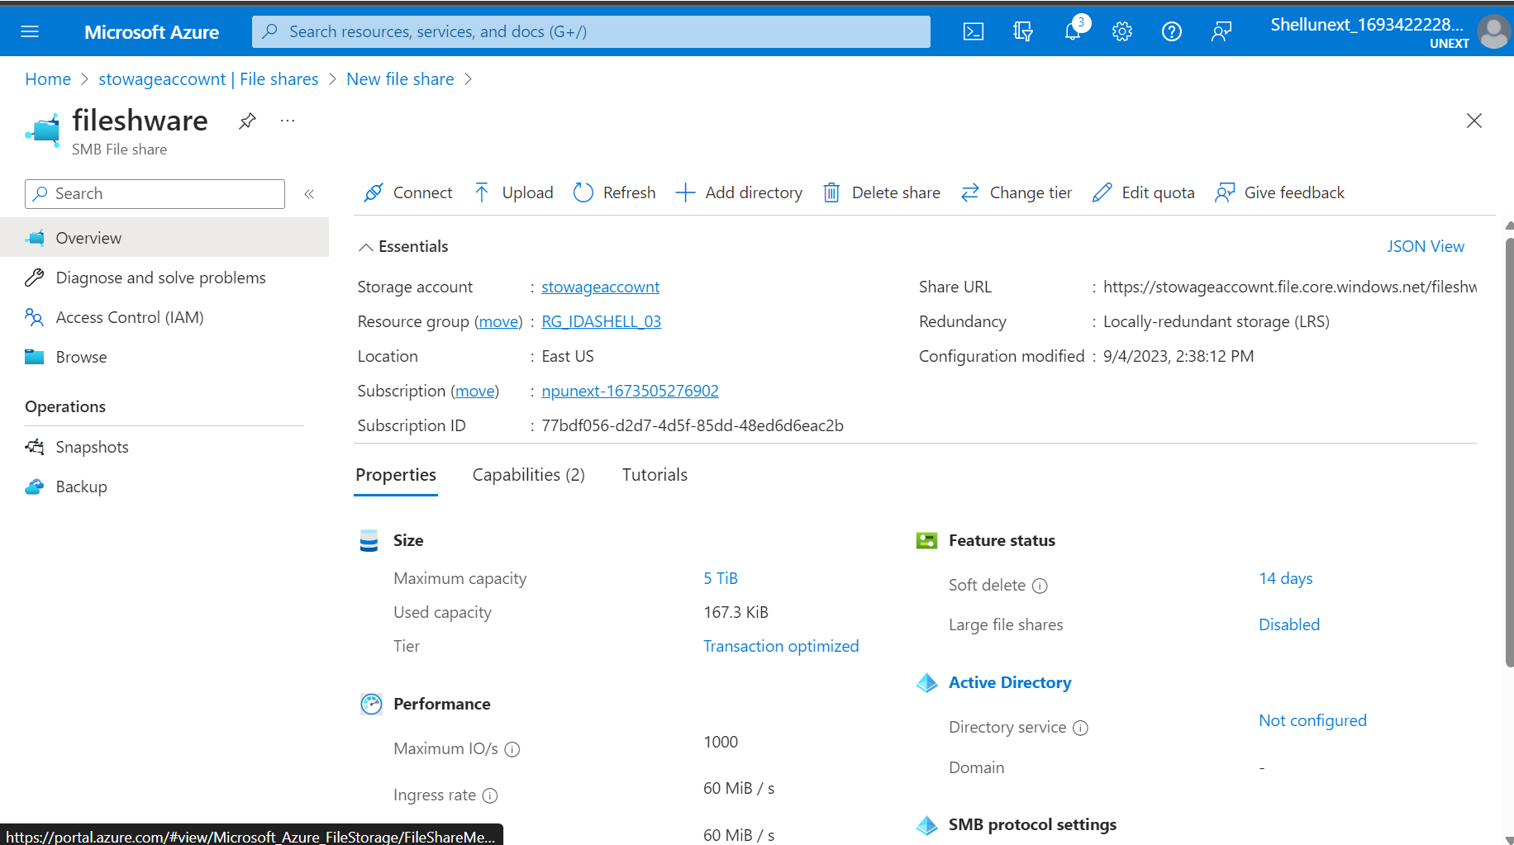
Azure Storage Account and File Share
Storage Account: to store data
Performance: local redundant, zone red, geo red, geo zone red
The same physical center, multiple computers - Local
Multiple zones with copies of data - Zone
Data stored in primary region, but copies available in secondary region as well - Geo
Only normal data copies, no zone data - Geo Zone
SLA: Service Level Agreement
API: connection between frontend and backend

Slide 48
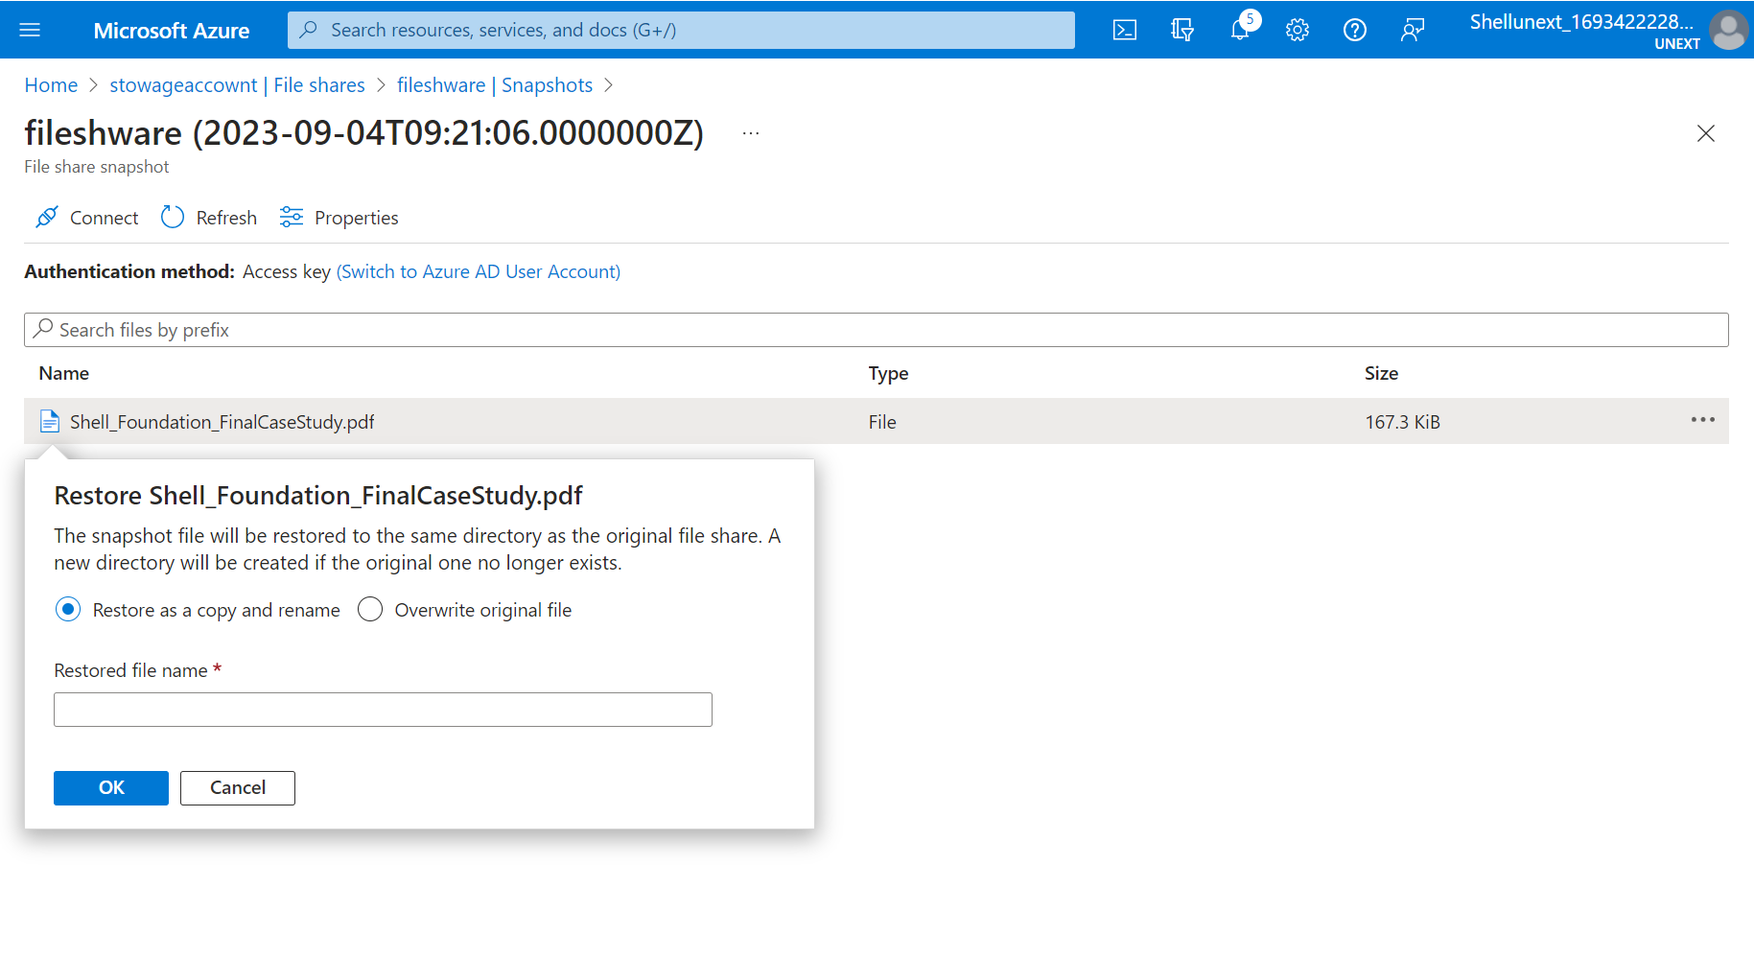
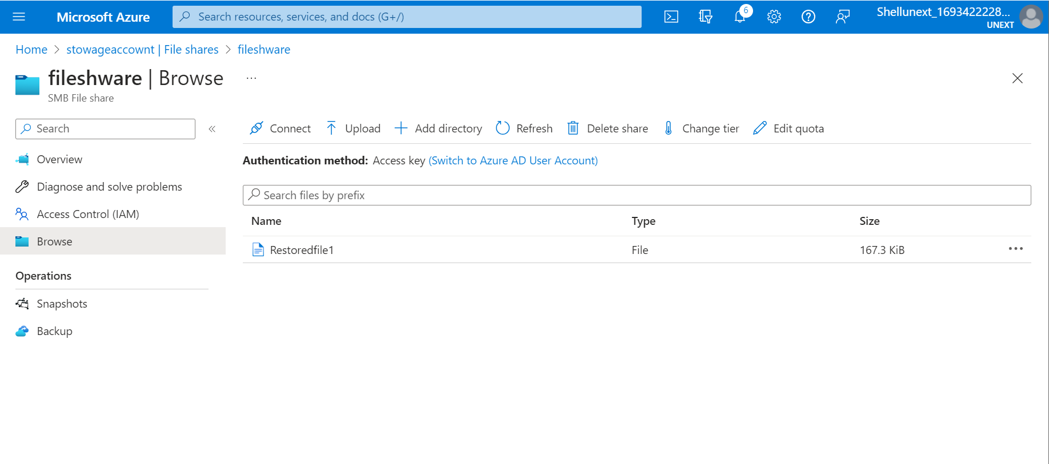
Restoring a deleted file using file share

Slide 49
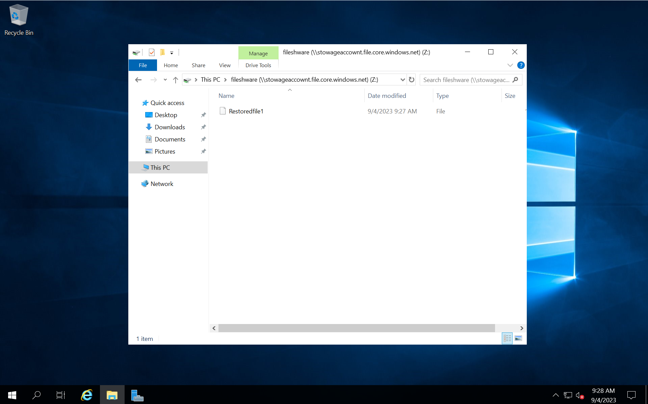
The file has been restored

Slide 50
Azure Storage types, Data Factory
13
Tuesday, 5th September, 2023

Slide 51
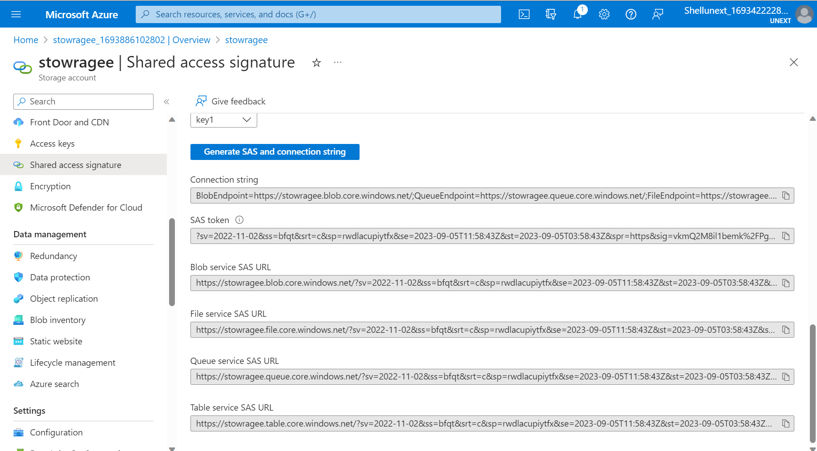
Azure Storage types, Data Factory
SaS: Shared Access Signature

Slide 52
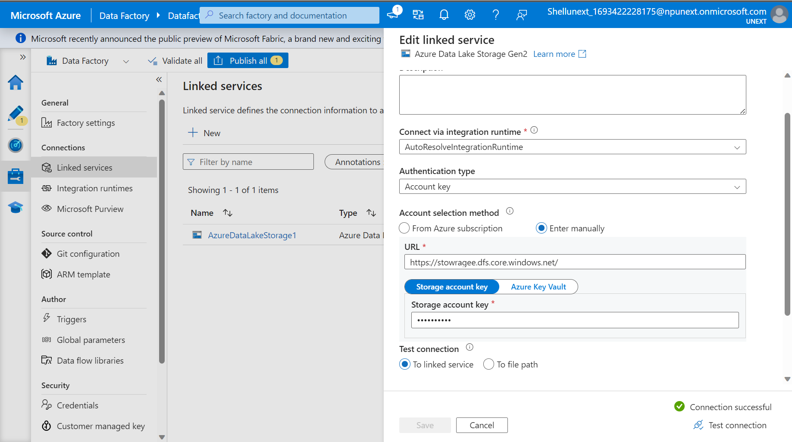
Introduction to ADF
Used for data flow activities, to create pipeline
ADF Components: pipeline, activity, datasets, linked services, integration runtime, trigger, data flow
ELT vs ETL
Integration Runtime:
Azure Auto Resolve: for all azure resources, Self-hosted integration runtime: for on premises, Azure SSIS (sql server integration system) ETL tool: lift and shift, take existing ssis package and run in azure environment.
Linked service

Slide 53
Azure Data Factory Day 2
14
Wednesday, 6th September, 2023

Slide 54
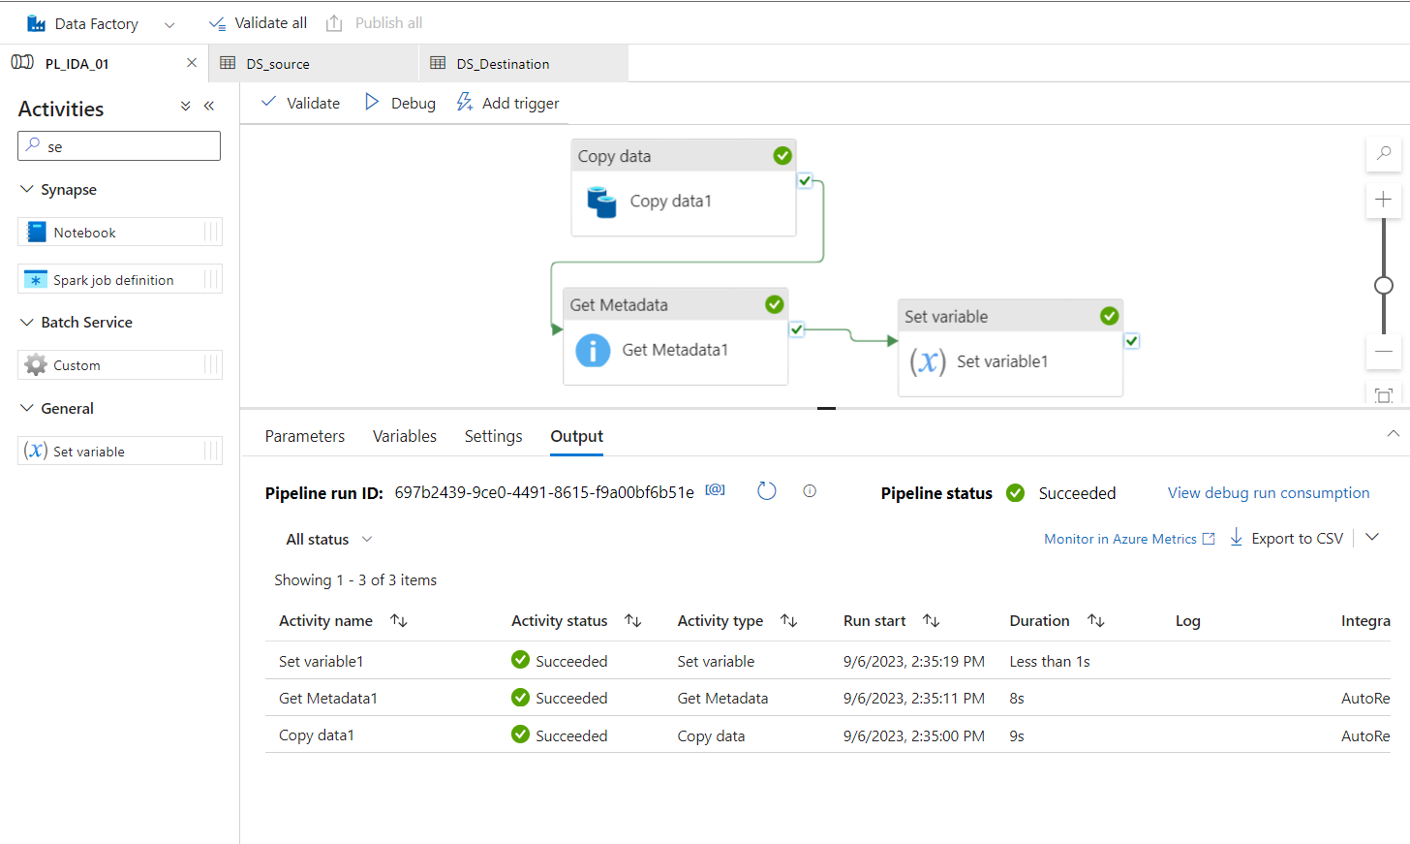
Azure Data Factory Day 2
Create pipeline
Monitor and debug pipeline
Triggered pipeline
Dataflow: transformation
Get metadata: get meta data, filter by size and store
Copy data: copies into new folder
If… Else

Slide 55
ADF Day 3
15
Thursday, 7th September, 2023

Slide 56
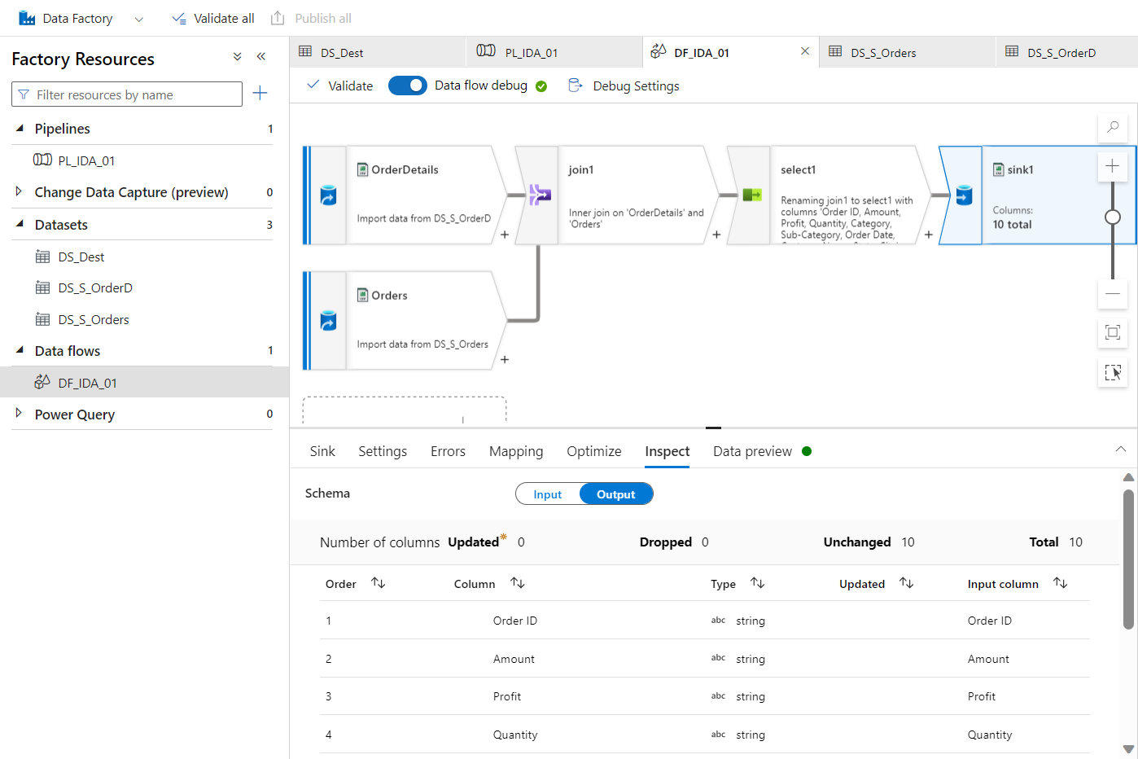
Azure Data Factory Day 3
Dataflow creation, Join, Sink

Slide 57
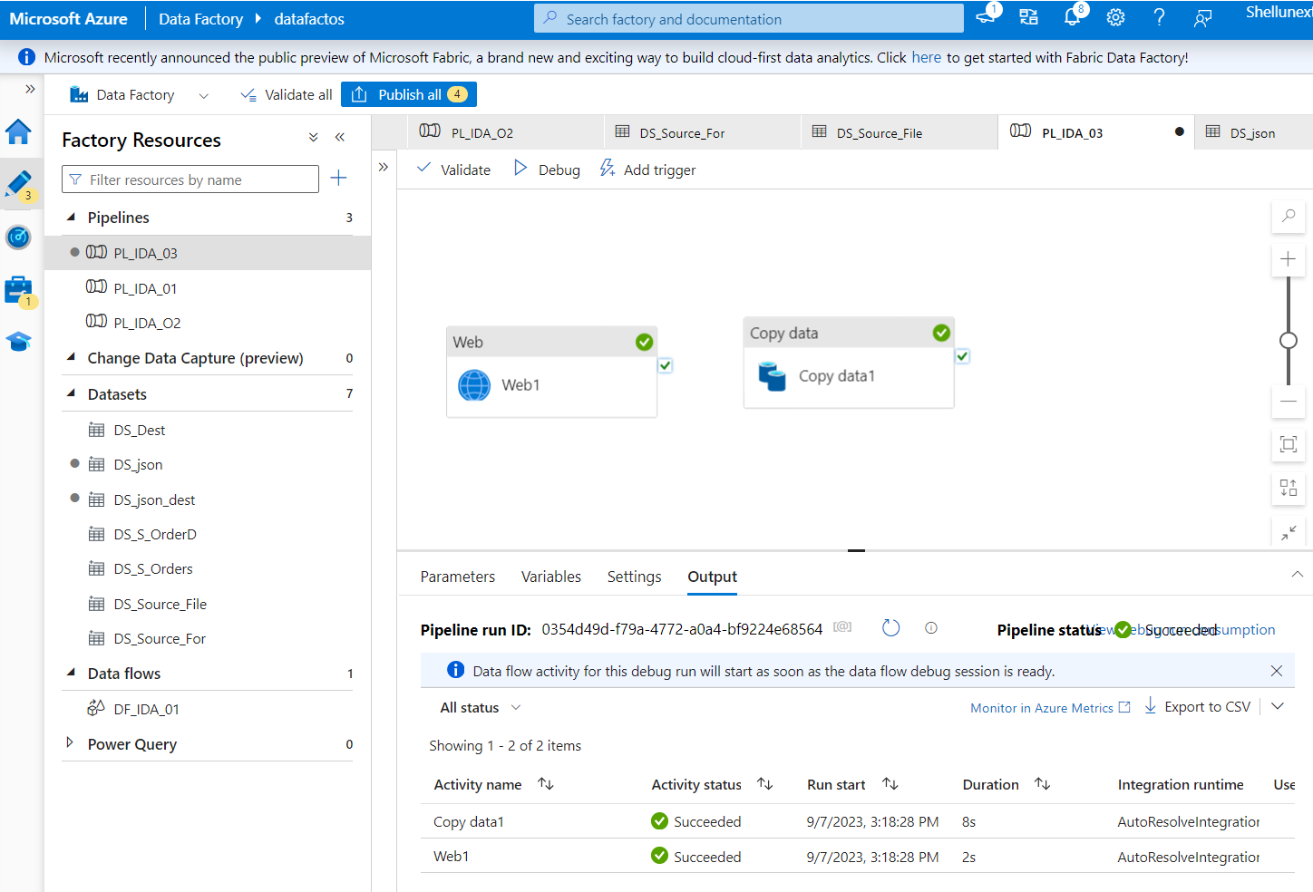
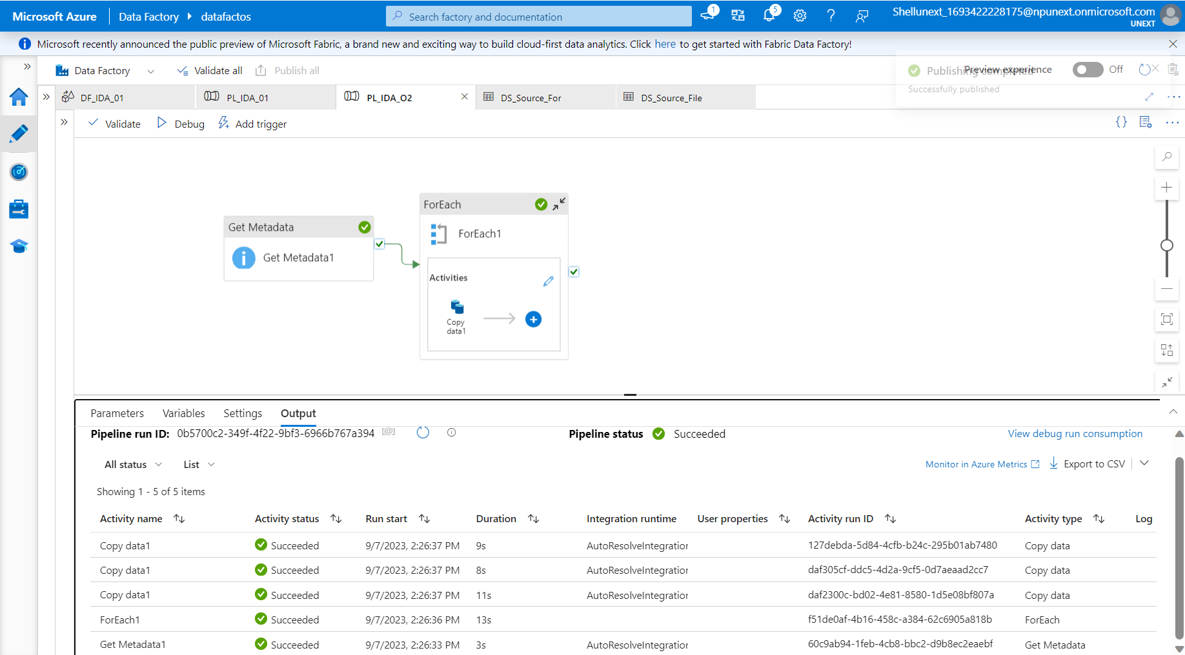
API: to get and post the data For Each

Slide 58
ADF Day 4
16
Friday, 8th September, 2023

Slide 59
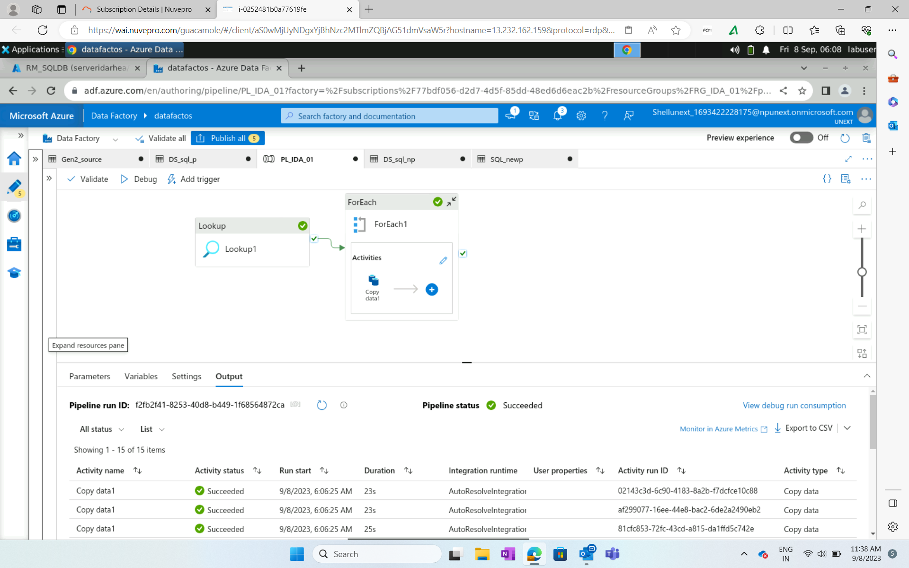
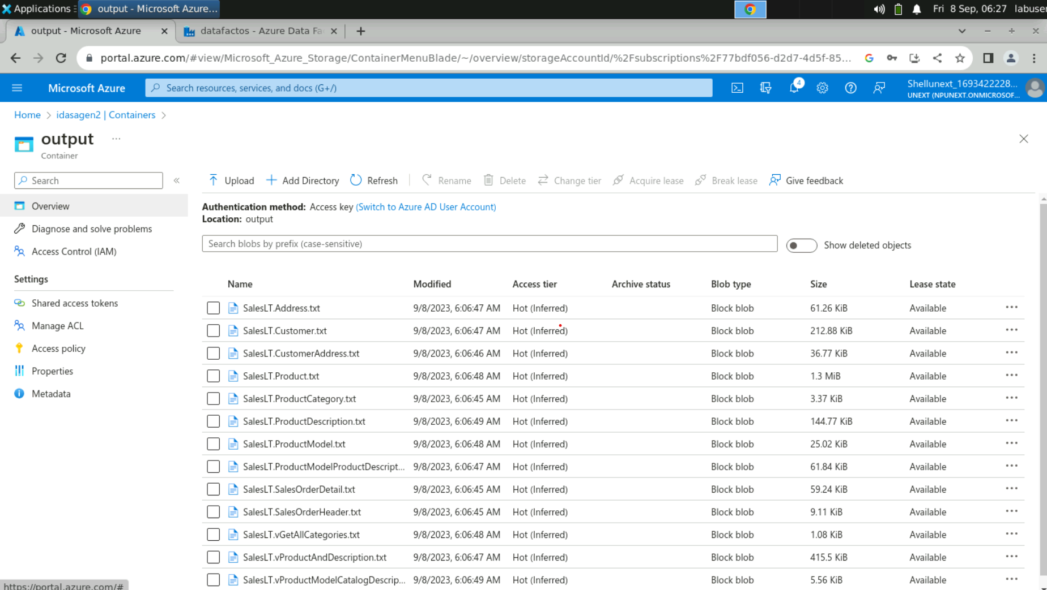
ADF Day 4

Slide 60
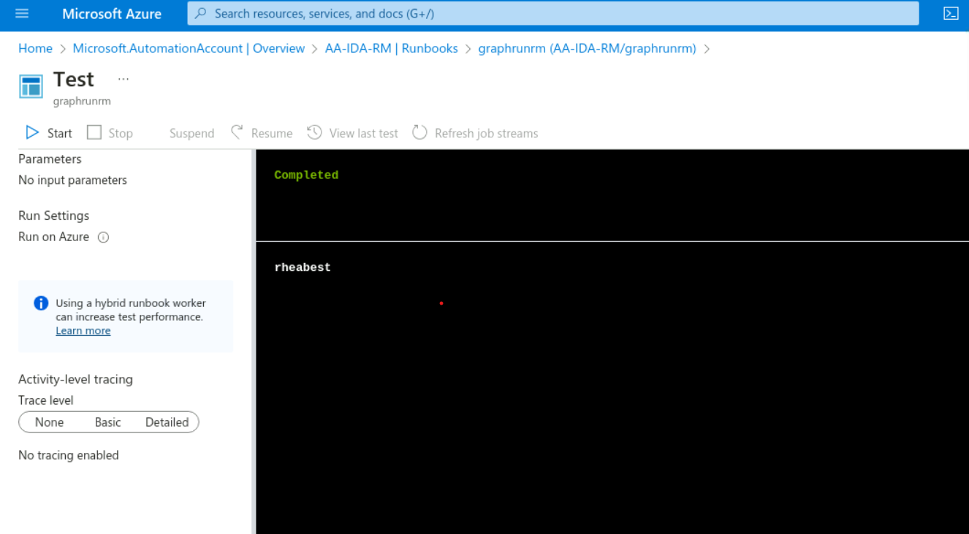
Run books

Slide 61
PowerBI Day 1
17
Wednesday, 13th September, 2023

Slide 62
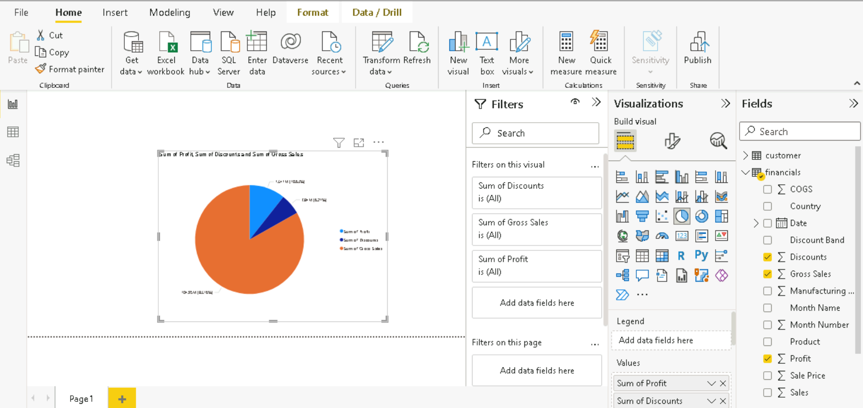
PowerBI Day 1
PBI Desktop: dev, PBI Services: publish, PBI Mobile: to see reports on mobile .pbix file
Power query: to do data transformation, available in powerbi desktop

Slide 63
Power BI Supports Multiple Data Connectors.
Power Query Editor: Used To Transform Data
Language Used At Back-end - M Language
Different Fields Of This Editor
Get Data In PBI Report And Transform It In Power Query Editor
Getting Familiar With Different Visuals
Parameter
Filters :
Visual Level
Page Level
Report Level
Slicers
DAX Measures
DAX Calculated Columns
RLS (Manage Roles)

Slide 64
PowerBI Day 2
18
Thursday, 14th September, 2023

Slide 65
PowerBI Day 2
Data Modeling : Establishing Relationships Between Tables
Univariant
Bivariant
Multivariant
Drill Through
Date Table
Connection Of SQL Server And Power BI

Slide 66
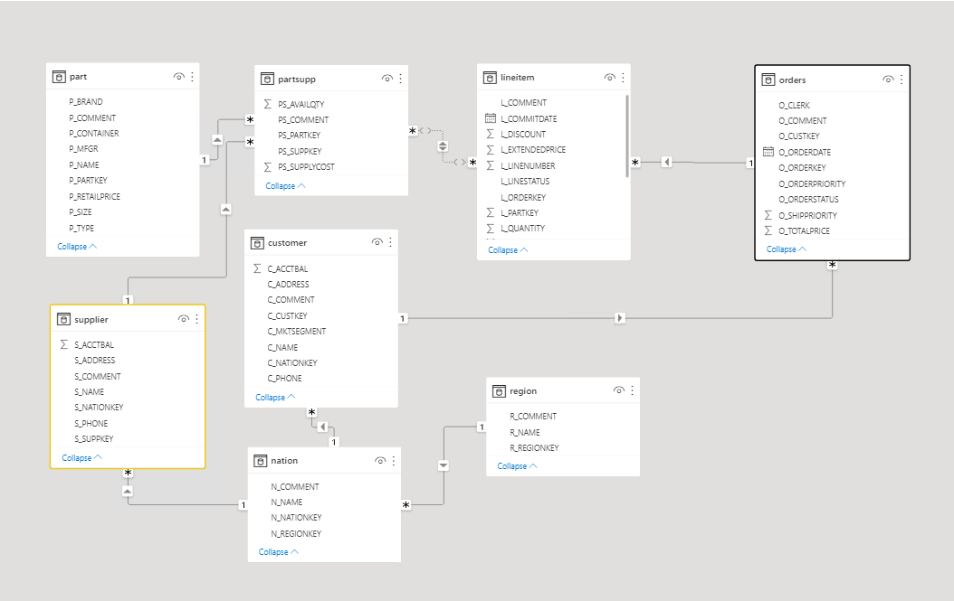
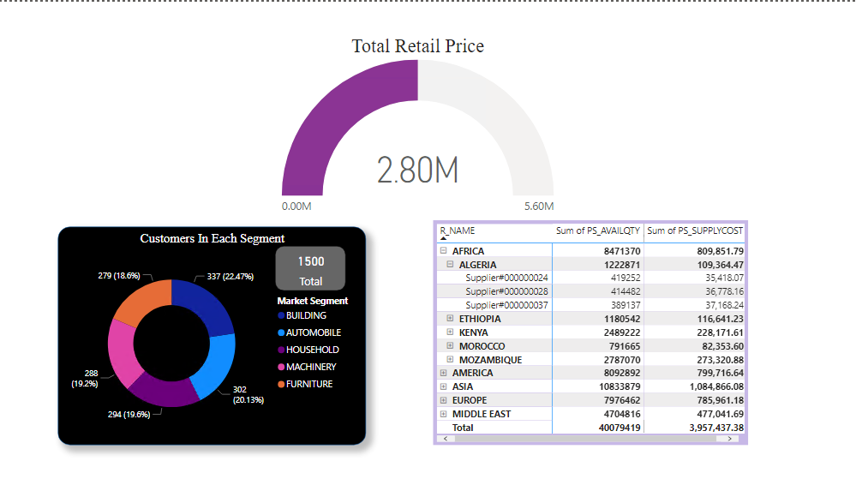
Relationship Diagram
Uni-variant, Bi-variant, Multi-variant

Slide 67
Python, PowerBI Hands on
19
Friday, 15th September, 2023

Slide 68
PowerBI Hands On, Python
Hands-on Assessment - Power BI
Jupyter Notebook Launch
Datatypes In Python:
Integer
Float
String
List
Dictionary
Tuple
Boolean
Arithmetic
Logic

Slide 69
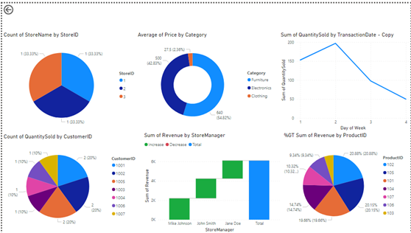
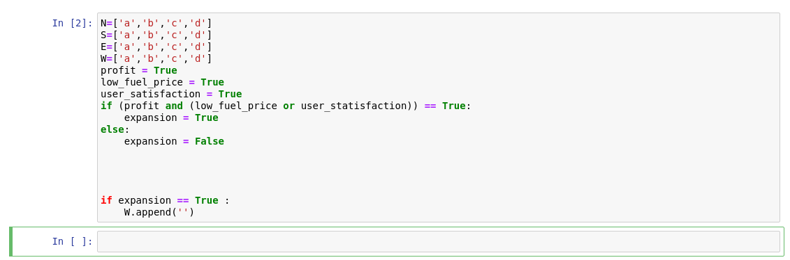

Slide 70
Python Day 2
20
Tuesday, 19th September, 2023

Slide 71
Python Day 2
Function Composition:
def fun1:
--------------
---------------
def fun2:
fun1:
---------------
---------------
Utility function: data preparation
Task: Write a function that calculates the volume of gas, formula is:
(Pressure * 1.0)/gasconst * temp

Slide 72
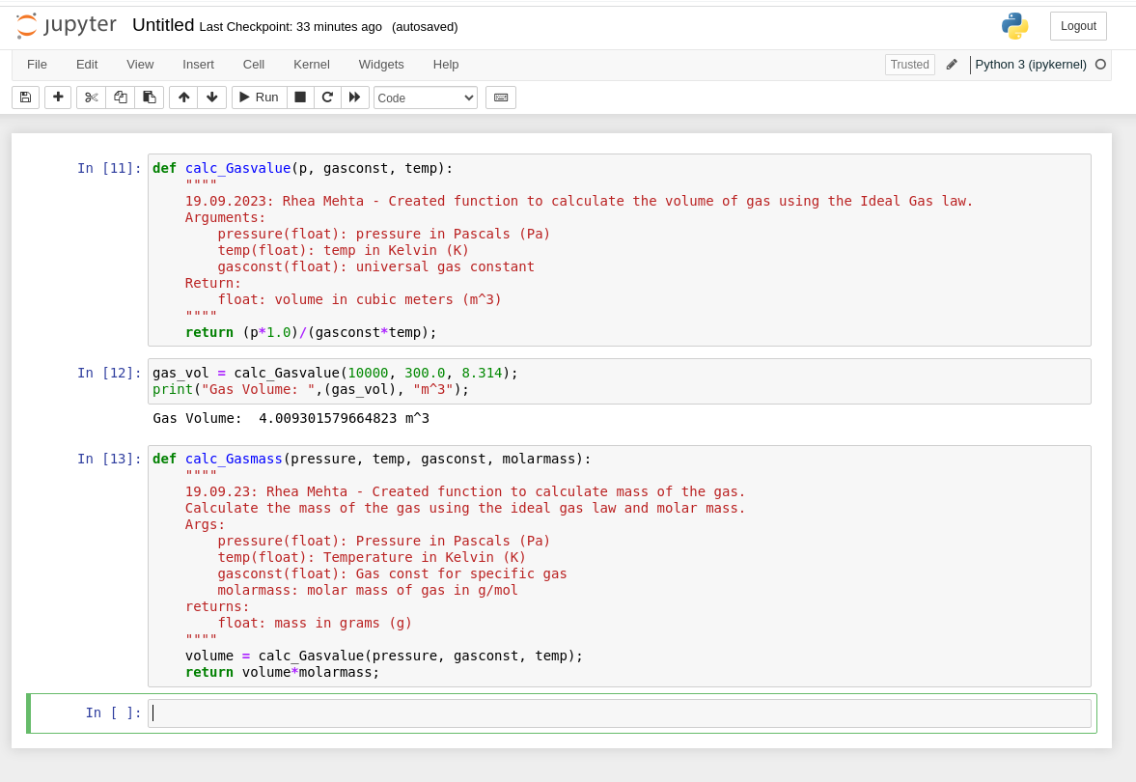

Slide 73
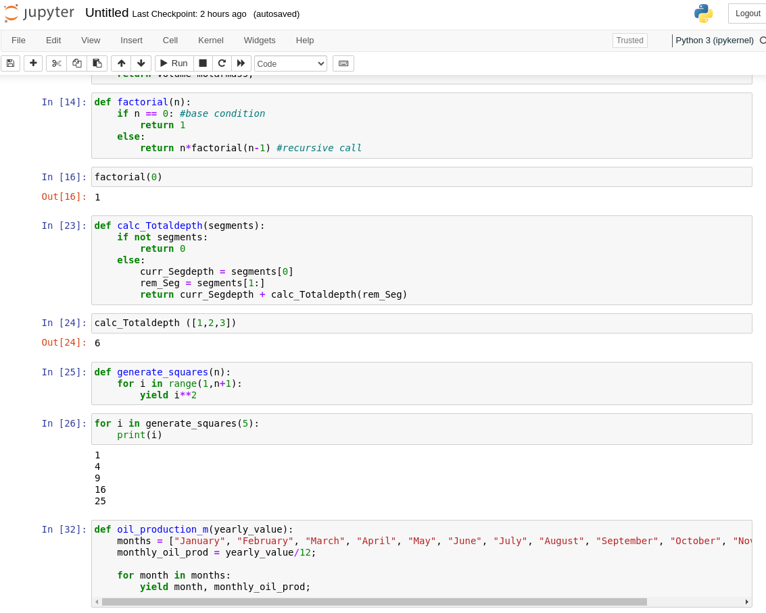
Generator function:
Def fun:
---------------
---------------
yield(a)
Yield is used with the generator function and is used to return multiple values (iterative) to the caller without terminating the program.

Slide 74
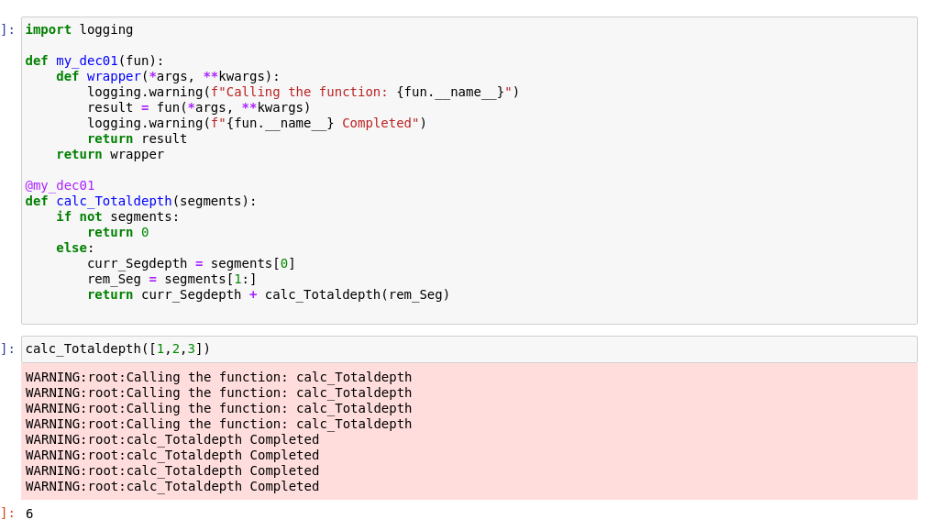
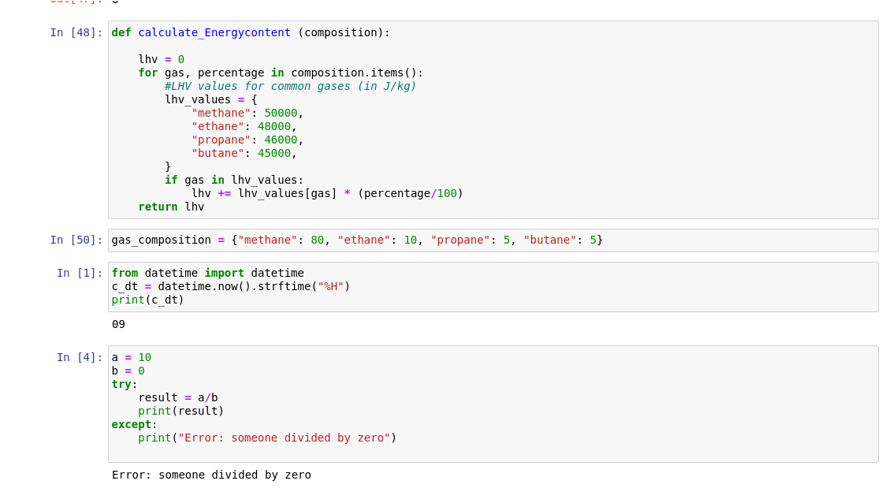

Slide 75
Pandas
21
Wednesday, 20th September, 2023

Slide 76
Pandas
1. Pandas : Panel Datasets
a. Dataframe
b. Functions on dataframe
c. Changing column to lowercase
d. Dropping Null Values
e. Dropping columns with Null Values
f. Filling null values
g. Describe columns
h. Value counts()
i. Selected rows or columns of dataframe
j. Conditional selection
2. Matplotlib
3. Arrays In Python

Slide 77
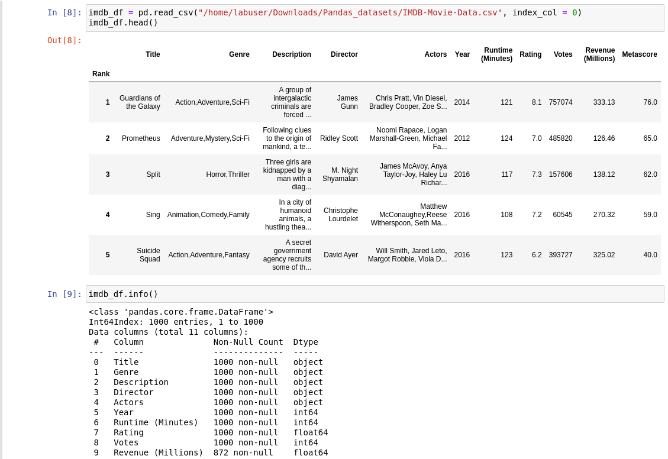
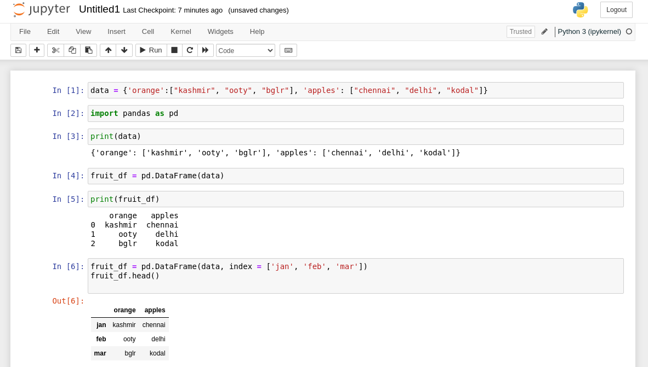

Slide 78
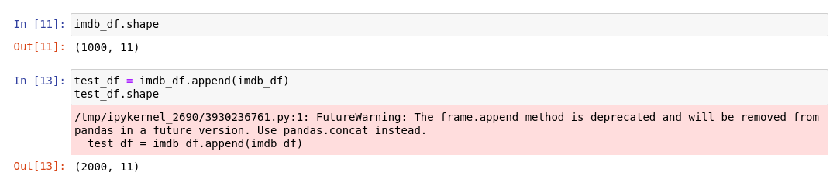
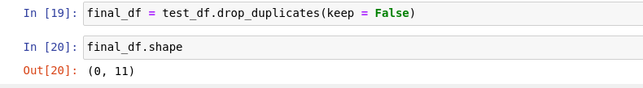
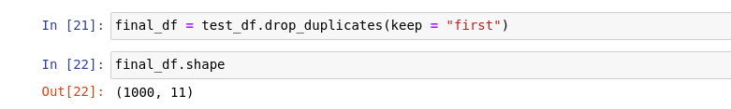
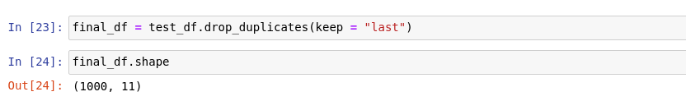
Imdb_df rows are appended to imdb_df, therefore 2000 rows.
Now, we will do duplicate handling.
Using drop_duplicates, it has three types, keep = first, keep = last, keep = false, default is keep = first. Keep = false deletes both copies, first keeps the first copy only, keep = last keeps the last duplicate only.

Slide 79
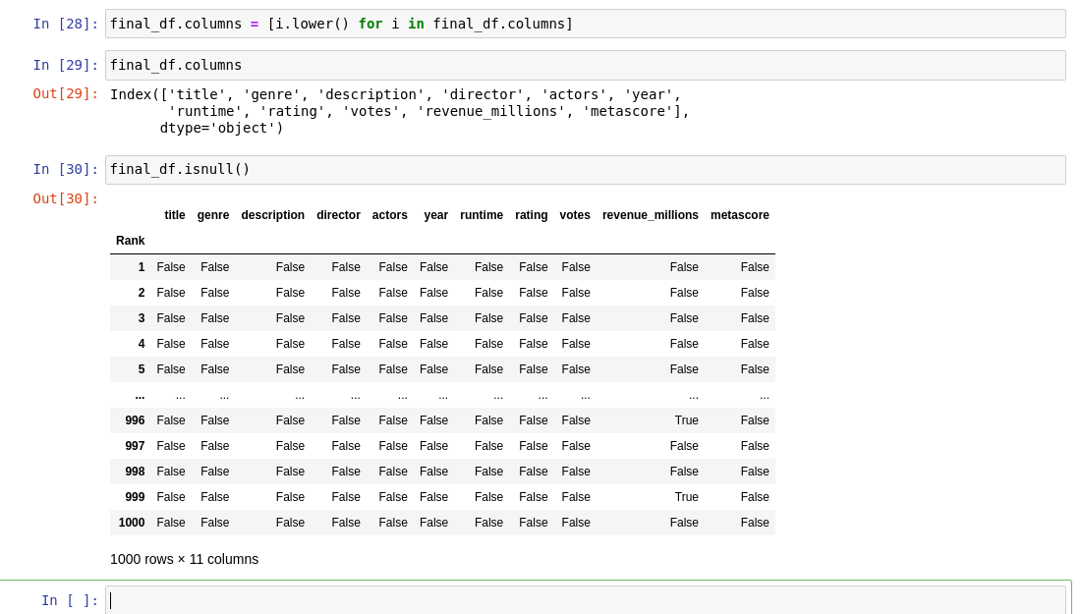
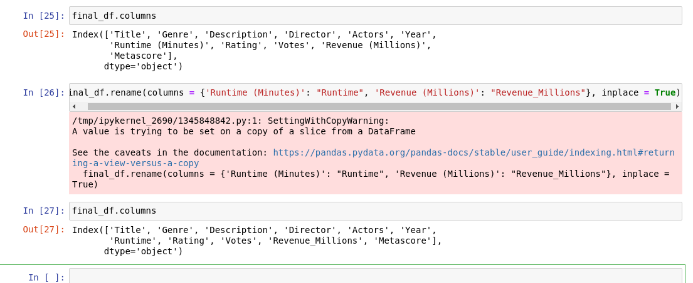
Renaming Columns

Slide 80
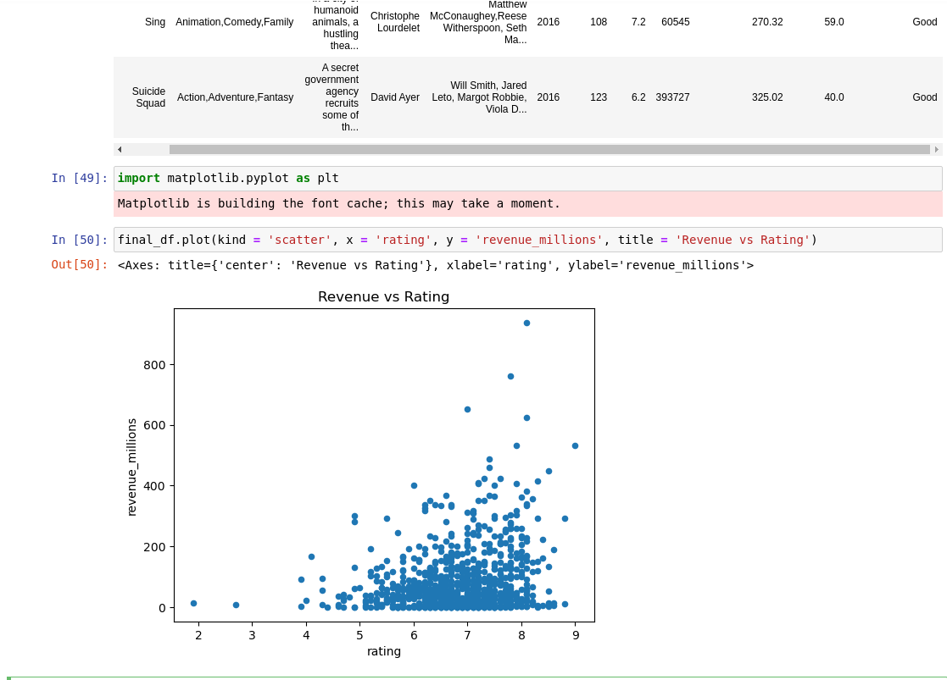
Matplotlib

Slide 81
PySpark
22
Thursday, September 21st, 2023

Slide 82
Spark:
Large scale data processing
Driver-executor
Spark splits work and gives to individual executors
Custom manager: takes input from driver and allocates tasks to individual workers and returns access back to driver node.
Languages supported in spark: Python, Scala, R, SQL
Lazy evaluation: until and unless you call for it, the transformation won't be executed
Saves memory and time
If particular record needed, transformation only applied on the record
Job depends on number of actions called.
RDD Operations:
Transformation: data manipulation activities, narrow and wide transformation
Actions
Actions -> Jobs -> Stages -> Tasks

Slide 83

RDD: Resilient Distributed Dataset
Able to recover quickly
1. Rdd
2. Dataframe (we will use as it solves our needs as data engineers)
3. Dataset (combines rdd and df)
Caching: Cache memory
Catalyst and Tungsten: converts to RDD for machine to understand.

Slide 84



Slide 85
PySpark Day 2
23
Friday, September 22nd, 2023

Slide 86
PySpark Day 2
Partitioning
Spark UI URL
SQL in PySpark
Drop duplicates
When – Otherwise condition
Concat and Functions
Caching
Joins
GroupBy

Slide 87







Slide 88



Slide 89
PySpark Day 3
24
Monday, 25th September, 2023

Slide 90
PySpark Day 3
Caching​
Persist and different storage levels​
Aggregation​
Managed and External Tables​
Partitioning​
For-Each

Slide 91
25

